Slide 1
Cloud computing

Slide 2
NIST: Five essential characteristics
On-demand self-service
Computing capabilities, disks are demanded over the network (no human inter
Broad network access
Capabilites are available through networks using standard protocols.
Used by thick or thin clients
Resource pooling
Computers are used by different users, depending on demand.
Rapid elasticity
Capabilities are provisioned and released as needed – fast.
Measured service
Control and optimize services
Source: The NIST Definition of Cloud Computing
http://csrc.nist.gov/publications/nistpubs/800-145/SP800-145.pdf
NIST National Institute of Standards and Technology, USA

Slide 3
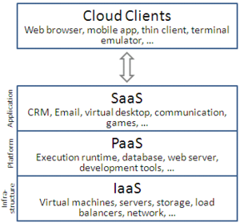
NIST: Service Models
Software as a Services (SaaS)
Consumer uses standard software from the cloud.
Example: Google docs, Microsoft Office 365, etc.
Platform as a Service (PaaS)
Consumer uses standard operating system, network etc. from the cloud
Consumer deploys proprietary application software to the cloud.
Infrastructure as a Service (IaaS)
Consumer uses computing power, disks, network etc. from the cloud
Consumer deploys proprietary operations system + application software to the cloud
Source: The NIST Definition of Cloud Computing
http://csrc.nist.gov/publications/nistpubs/800-145/SP800-145.pdf
Source: https://en.wikipedia.org/wiki/Cloud_computing

Slide 4
NIST: Deployment Models
Private cloud
Cloud is used by a single organization.
Owned and managed by the organization or a third party.
Community cloud
Cloud is used by a community of organizations
With shared concerns: Security, etc.
Public cloud
Cloud is used by the general public
Owned and managed by business, academic or government organization
Hybrid cloud
Combination of 2-3 of the above cloud models
Source: The NIST Definition of Cloud Computing
http://csrc.nist.gov/publications/nistpubs/800-145/SP800-145.pdf

Slide 5
Payment models
Without cloud
Buy hardware + software before you need it.
You must pay before you earn.
With cloud
Pay for hardware + software as you need it (if you need it).
Pay as you go
You must pay as you earn.
No upfront infrastructure costs

Slide 6
Hardware virtualization
A physical machine (computer) is divided into a number of virtual machines.
Virtual machines act like physical machines.
Virtual machines can be opened, closed and even moved to another physical machine.
Example virtualization software
Oracle Virtual Box
VMWare
Microsoft Hyper-V

Slide 7
Some clouds
Amazon 2006
Microsoft Azure 2008
Oracle Cloud 2012

