Slide 1
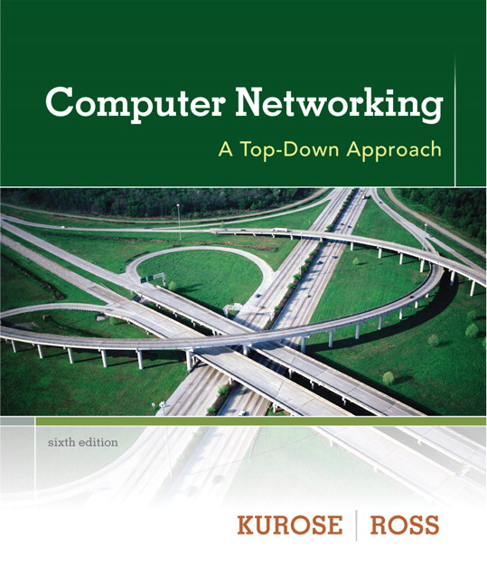
Chapter 3 Transport Layer
Computer Networking: A Top Down Approach 6th edition Jim Kurose, Keith Ross Addison-Wesley March 2012
All material copyright 1996-2012
J.F Kurose and K.W. Ross, All Rights Reserved

Slide 2
Chapter 3: Transport Layer
our goals:
understand principles behind transport layer services:
multiplexing, demultiplexing
reliable data transfer
flow control
congestion control
learn about Internet transport layer protocols:
UDP: connectionless transport
TCP: connection-oriented reliable transport
TCP congestion control

Slide 3
Chapter 3 outline
3.1 transport-layer services
3.2 multiplexing and demultiplexing
3.3 connectionless transport: UDP
3.4 principles of reliable data transfer
3.5 connection-oriented transport: TCP
segment structure
reliable data transfer
flow control
connection management
3.6 principles of congestion control
3.7 TCP congestion control

Slide 4
Transport services and protocols
application
transport
network
data link
physical
provide logical communication between app processes running on different hosts
transport protocols run in end systems
send side: breaks app messages into segments, passes to network layer
rcv side: reassembles segments into messages, passes to app layer
more than one transport protocol available to apps
Internet: TCP and UDP
logical end-end transport
application
transport
network
data link
physical

Slide 5
Transport vs. network layer
network layer: logical communication between hosts
transport layer: logical communication between processes
relies on, enhances, network layer services
household analogy:
12 kids in Ann’s house sending letters to 12 kids in Bill’s house:
hosts = houses
processes = kids
app messages = letters in envelopes
transport protocol = Ann and Bill who demux to in-house siblings
network-layer protocol = postal service

Slide 6
Internet transport-layer protocols
reliable, in-order delivery (TCP)
congestion control
flow control
connection setup
unreliable, unordered delivery: UDP
no-frills extension of “best-effort” IP
services not available:
delay guarantees
bandwidth guarantees
application
transport
network
data link
physical
network
data link
physical
network
data link
physical
network
data link
physical
logical end-end transport
network
data link
physical
network
data link
physical
network
data link
physical
network
data link
physical
application
transport
network
data link
physical

Slide 7
Chapter 3 outline
3.1 transport-layer services
3.2 multiplexing and demultiplexing
3.3 connectionless transport: UDP
3.4 principles of reliable data transfer
3.5 connection-oriented transport: TCP
segment structure
reliable data transfer
flow control
connection management
3.6 principles of congestion control
3.7 TCP congestion control

Slide 8
Multiplexing/demultiplexing
multiplexing at sender:
handle data from multiple
sockets, add transport header (later used for demultiplexing)
demultiplexing at receiver:
use header info to deliver
received segments to correct
socket
application
application
P1
P2
application
socket
P3
transport
P4
process
transport
network
transport
network
link
network
link
physical
link
physical
physical

Slide 9
How demultiplexing works
host receives IP datagrams
each datagram has source IP address, destination IP address
each datagram carries one transport-layer segment
each segment has source, destination port number
host uses IP addresses & port numbers to direct segment to appropriate socket
32 bits
source port #
dest port #
other header fields
application
data
(payload)
TCP/UDP segment format

Slide 10
Chapter 3 outline
3.1 transport-layer services
3.2 multiplexing and demultiplexing
3.3 connectionless transport: UDP
3.4 principles of reliable data transfer
3.5 connection-oriented transport: TCP
segment structure
reliable data transfer
flow control
connection management
3.6 principles of congestion control
3.7 TCP congestion control

Slide 11
UDP: User Datagram Protocol [RFC 768]
“no frills,” “bare bones” Internet transport protocol
“best effort” service, UDP segments may be:
lost
delivered out-of-order to app
connectionless:
no handshaking between UDP sender, receiver
each UDP segment handled independently of others
UDP use:
streaming multimedia apps (loss tolerant, rate sensitive)
DNS
SNMP
reliable transfer over UDP:
add reliability at application layer
application-specific error recovery!

Slide 12
UDP: segment header
length, in bytes of UDP segment, including header
32 bits
source port #
dest port #
length
checksum
why is there a UDP?
no connection establishment (which can add delay)
simple: no connection state at sender, receiver
small header size
no congestion control: UDP can blast away as fast as desired
application
data
(payload)
UDP segment format

Slide 13
Chapter 3 outline
3.1 transport-layer services
3.2 multiplexing and demultiplexing
3.3 connectionless transport: UDP
3.4 principles of reliable data transfer
3.5 connection-oriented transport: TCP
segment structure
reliable data transfer
flow control
connection management
3.6 principles of congestion control
3.7 TCP congestion control

Slide 14
TCP: Overview RFCs: 793,1122,1323, 2018, 2581
point-to-point:
one sender, one receiver
reliable, in-order byte steam:
no “message boundaries”
pipelined:
TCP congestion and flow control set window size
full duplex data:
bi-directional data flow in same connection
MSS: maximum segment size
connection-oriented:
handshaking (exchange of control msgs) inits sender, receiver state before data exchange
flow controlled:
sender will not overwhelm receiver

Slide 15
TCP segment structure
32 bits
URG: urgent data
(generally not used)
counting
by bytes
of data
(not segments!)
source port #
dest port #
sequence number
ACK: ACK #
valid
acknowledgement number
head
len
not
used
U
receive window
A
PSH: push data now
(generally not used)
P
R
S
F
# bytes
rcvr willing
to accept
checksum
Urg data pointer
RST, SYN, FIN:
connection estab
(setup, teardown
commands)
options (variable length)
application
data
(variable length)
Internet
checksum
(as in UDP)

