Slide 1
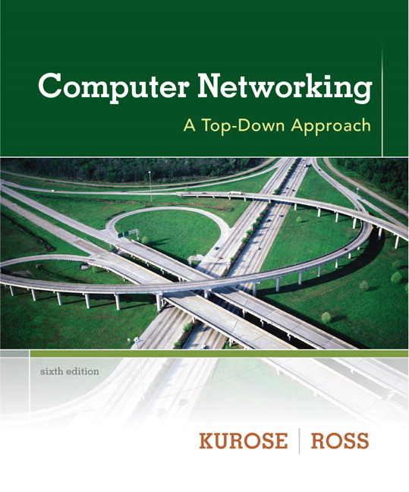

Chapter 8
Security
Computer Networking: A Top Down Approach
6th edition
Jim Kurose, Keith Ross
Addison-Wesley
March 2012
All material copyright 1996-2012
J.F Kurose and K.W. Ross, All Rights Reserved

Slide 2
Chapter 8: Network Security
Chapter goals:
understand principles of network security:
  cryptography and its many uses beyond “confidentiality”
  authentication
  message integrity
security in practice:
  firewalls and intrusion detection systems
  security in application, transport, network, link layers

Slide 3
Chapter 8 roadmap
8.1 What is network security?
8.2 Principles of cryptography
8.3 Message integrity, authentication
8.4 Securing e-mail
8.5 Securing TCP connections: SSL
8.6 Network layer security: IPsec
8.7 Securing wireless LANs
8.8 Operational security: firewalls and IDS

Slide 4
What is network security?
confidentiality: only sender, intended receiver should “understand” message contents
  sender encrypts message
  receiver decrypts message
authentication: sender, receiver want to confirm identity of each other
message integrity: sender, receiver want to ensure message not altered (in transit, or afterwards) without detection
access and availability: services must be accessible and available to users

Slide 5



Friends and enemies: Alice, Bob, Trudy
well-known in network security world
Bob, Alice (lovers!) want to communicate “securely”
Trudy (intruder) may intercept, delete, add messages
Alice
Bob
channel
data, control messages
secure
sender
s
data
secure
receiver
data
Trudy

Slide 6
Who might Bob, Alice be?
… well, real-life Bobs and Alices!
Web browser/server for electronic transactions (e.g., on-line purchases)
on-line banking client/server
DNS servers
routers exchanging routing table updates
other examples?

Slide 7
There are bad guys (and girls) out there!
Q: What can a “bad guy” do?
A: A lot! See section 1.6
  eavesdrop: intercept messages
  actively insert messages into connection
  impersonation: can fake (spoof) source address in packet (or any field in packet)
  hijacking: “take over” ongoing connection by removing sender or receiver, inserting himself in place
  denial of service: prevent service from being used by others (e.g., by overloading resources)

Slide 8
Chapter 8 roadmap
8.1 What is network security?
8.2 Principles of cryptography
8.3 Message integrity, authentication
8.4 Securing e-mail
8.5 Securing TCP connections: SSL
8.6 Network layer security: IPsec
8.7 Securing wireless LANs
8.8 Operational security: firewalls and IDS

Slide 9
The language of cryptography
Alice’s
encryption
key
Bob’s
decryption
key
K
K
A
B
plaintext
encryption
algorithm
ciphertext
decryption
algorithm
plaintext
m plaintext message
K_{A}(m) ciphertext, encrypted with key K_{A}
m = K_{B}(K_{A}(m))

Slide 10
Breaking an encryption scheme
cipher-text only attack: Trudy has ciphertext she can analyze
two approaches:
  brute force: search through all keys
  statistical analysis
known-plaintext attack: Trudy has plaintext corresponding to ciphertext
  e.g., in monoalphabetic cipher, Trudy determines pairings for a,l,i,c,e,b,o,
chosen-plaintext attack: Trudy can get ciphertext for chosen plaintext

Slide 11
Symmetric key cryptography
K
K
S
S
plaintext
message, m
encryption
algorithm
ciphertext
decryption
algorithm
plaintext
K (m)
m = K_{S}(K_{S}(m))
S
symmetric key crypto: Bob and Alice share same (symmetric) key: K
e.g., key is knowing substitution pattern in mono alphabetic substitution cipher
Q: how do Bob and Alice agree on key value?
S

Slide 12
Simple encryption scheme
substitution cipher: substituting one thing for another
  monoalphabetic cipher: substitute one letter for another
plaintext: abcdefghijklmnopqrstuvwxyz
ciphertext: mnbvcxzasdfghjklpoiuytrewq
e.g.:
Plaintext: bob. i love you. alice
ciphertext: nkn. s gktc wky. mgsbc
Encryption key: mapping from set of 26 letters
to set of 26 letters

Slide 13
Symmetric key crypto: DES
DES: Data Encryption Standard
US encryption standard [NIST 1993]
56-bit symmetric key, 64-bit plaintext input
block cipher with cipher block chaining
how secure is DES?
  DES Challenge: 56-bit-key-encrypted phrase decrypted (brute force) in less than a day
  no known good analytic attack
making DES more secure:
  3DES: encrypt 3 times with 3 different keys

Slide 14
AES: Advanced Encryption Standard
symmetric-key NIST standard, replaced DES (Nov 2001)
processes data in 128 bit blocks
128, 192, or 256 bit keys
brute force decryption (try each key) taking 1 sec on DES, takes 149 trillion years for AES

Slide 15
Public Key Cryptography
symmetric key crypto
requires sender, receiver know shared secret key
Q: how to agree on key in first place (particularly if never “met”)?
public key crypto
radically different approach [Diffie-Hellman76, RSA78]
sender, receiver do not share secret key
public encryption key known to all
private decryption key known only to receiver

Slide 16
Public key cryptography
+
Bob’s public
key
K
B
-
Bob’s private
key
K
B
plaintext
message, m
encryption
algorithm
ciphertext
decryption
algorithm
plaintext
message
+
K (m)
-
+
B
m = K (K (m))
B
B

Slide 17
Public key encryption algorithms
requirements:
.
.
+
-
1
need K ( ) and K ( ) such that
B
B
-
+
K (K (m)) = m
B
B
2
+
given public key K , it should be impossible to compute private key K
B
-
B
RSA: Rivest, Shamir, Adelson algorithm

Slide 18
RSA: another important property
The following property will be very useful later:
-
+
+
-
K (K (m)) = m
=
K (K (m))
B
B
B
B
use public key first, followed by private key
use private key first, followed by public key
result is the same!

Slide 19
RSA in practice: session keys
exponentiation in RSA is computationally intensive
DES is at least 100 times faster than RSA
use public key cryto to establish secure connection, then establish second key – symmetric session key – for encrypting data
session key, K_{S}
Bob and Alice use RSA to exchange a symmetric key K_{S}
once both have K_{S}, they use symmetric key cryptography

Slide 20
Chapter 8 roadmap
8.1 What is network security?
8.2 Principles of cryptography
8.3 Message integrity, authentication
8.4 Securing e-mail
8.5 Securing TCP connections: SSL
8.6 Network layer security: IPsec
8.7 Securing wireless LANs
8.8 Operational security: firewalls and IDS

Slide 21
Digital signatures
cryptographic technique analogous to hand-written signatures:
sender (Bob) digitally signs document, establishing he is document owner/creator.
verifiable, nonforgeable: recipient (Alice) can prove to someone that Bob, and no one else (including Alice), must have signed document

Slide 22
Digital signatures
simple digital signature for message m:
Bob signs m by encrypting with his private key K_{B}, creating “signed” message, K_{B}(m)
-
-
Bob’s message, m
-
Bob’s private
key
-
K
m,K
(m)
B
B
Dear Alice
Oh, how I have missed you. I think of you all the time! …(blah blah blah)
Bob
Bob’s message, m, signed (encrypted) with his private key
Public key
encryption
algorithm

Slide 23
Digital signatures
-
suppose Alice receives msg m, with signature: m, K_{B}(m)
Alice verifies m signed by Bob by applying Bob’s public key K_{B} to K_{B}(m) then checks K_{B}(K_{B}(m) ) = m.
If K_{B}(K_{B}(m) ) = m, whoever signed m must have used Bob’s private key.
+
-
+
-
+
-
Alice thus verifies that:
  Bob signed m
  no one else signed m
  Bob signed m and not m‘
non-repudiation:
  Alice can take m, and signature K_{B}(m) to court and prove that Bob signed m
-

Slide 24
Message digests
large
message
m
H: Hash
Function
computationally expensive to public-key-encrypt long messages
goal: fixed-length, easy- to-compute digital “fingerprint”
apply hash function H to m, get fixed size message digest, H(m).
H(m)
Hash function properties:
many-to-1
produces fixed-size msg digest (fingerprint)
given message digest x, computationally infeasible to find m such that x = H(m)

Slide 25
Digital signature = signed message digest
Bob sends digitally signed message:
Alice verifies signature, integrity of digitally signed message:
large
message
m
H: Hash
function
H(m)
encrypted
msg digest
-
K_{B}(H(m))
Bob’s
private
key
digital
signature
(encrypt)
large
message
m
-
Bob’s
public
key
digital
signature
(decrypt)
K
B
+
H: Hash
function
K
encrypted
msg digest
B
+
-
K_{B}(H(m))
H(m)
H(m)
equal
?

Slide 26
Hash function algorithms
MD5 hash function widely used (RFC 1321)
  computes 128-bit message digest in 4-step process.
  arbitrary 128-bit string x, appears difficult to construct msg m whose MD5 hash is equal to x
SHA-1 is also used
  US standard [NIST, FIPS PUB 180-1]
  160-bit message digest

Slide 27
Public-key certification
motivation: Trudy plays pizza prank on Bob
  Trudy creates e-mail order:
  Dear Pizza Store, Please deliver to me four pepperoni pizzas. Thank you, Bob
  Trudy signs order with her private key
  Trudy sends order to Pizza Store
  Trudy sends to Pizza Store her public key, but says it’s Bob’s public key
  Pizza Store verifies signature; then delivers four pepperoni pizzas to Bob
  Bob doesn’t even like pepperoni

Slide 28
Certification authorities
certification authority (CA): binds public key to particular entity, E.
E (person, router) registers its public key with CA.
  E provides “proof of identity” to CA.
  CA creates certificate binding E to its public key.
  certificate containing E’s public key digitally signed by CA – CA says “this is E’s public key”
Bob’s
public
key
digital
signature
(encrypt)
+
K
+
B
K
B
CA
private
key
certificate for Bob’s public key, signed by CA
-
Bob’s
identifying information
K
CA

Slide 29
Certification authorities
when Alice wants Bob’s public key:
  gets Bob’s certificate (Bob or elsewhere).
  apply CA’s public key to Bob’s certificate, get Bob’s public key
+
digital
signature
(decrypt)
Bob’s
public
key
K
B
+
K
B
CA
public
key
+
K
CA

Slide 30
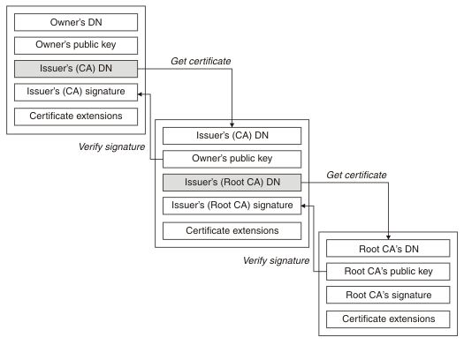
Certificate chains
This server uses an depcreates hash algorithm SHA-1
https://www-01.ibm.com/support/knowledgecenter/SSFKSJ_7.1.0/com.ibm.mq.doc/sy10600_.htm

Slide 31
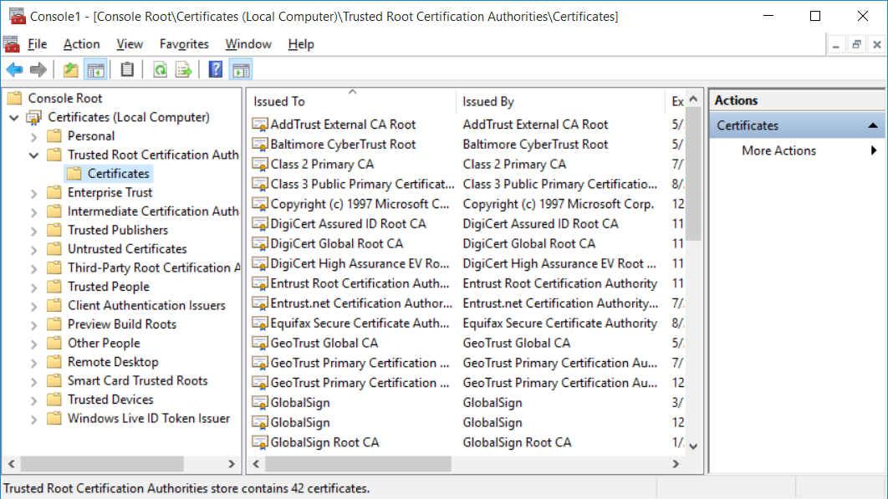
Root certificates
Certificates are verified using a chain of trust.
The trust anchor is called a root certificate authority (CA)
Root certificates are usually self signed
Standard X.509
Windows (and other operation systems) comes with a lot of root cerficicates insalled.
How to see your installed root cerfificates:
Microsoft Management Console
  Mmc from the command line
Add/Remove Snap-in
  Computer Account: finish + OK
Open Trusted Root Certificatin Authorities
Source
  http://www.jayway.com/2014/09/03/creating-self-signed-certificates-with-makecert-exe-for-development/

Slide 32
Chapter 8 roadmap
8.1 What is network security?
8.2 Principles of cryptography
8.3 Message integrity
8.4 Securing e-mail
8.5 Securing TCP connections: SSL
8.6 Network layer security: IPsec
8.7 Securing wireless LANs
8.8 Operational security: firewalls and IDS

Slide 33
SSL: Secure Sockets Layer
widely deployed security protocol
  supported by almost all browsers, web servers
  https
  billions $/year over SSL
  TCP port 443
mechanisms: [Woo 1994], implementation: Netscape
Variation (newer) TLS: transport layer security, RFC 2246
provides
  confidentiality
  integrity
  authentication
original goals:
  Web e-commerce transactions
  encryption (especially credit-card numbers)
  Web-server authentication
  optional client authentication
  minimum hassle in doing business with new merchant
available to all TCP applications
  secure socket interface

Slide 34
SSL and TCP/IP
Application
Application
SSL
TCP
TCP
IP
IP
normal application
application with SSL
SSL provides application programming interface (API) to applications
C# and Java SSL libraries/classes readily available

Slide 35
SSL connection
handshake: ClientHello
handshake: ServerHello
handshake: Certificate
handshake: ServerHelloDone
handshake: ClientKeyExchange
ChangeCipherSpec
everything
henceforth
is encrypted
handshake: Finished
ChangeCipherSpec
handshake: Finished
application_data
application_data
Alert: warning, close_notify
TCP FIN follows

Slide 36
C# API, SslStream
The class SslStream wraps an ordinary Stream providing secure communication
Example
  SimpleSslClient, to acces a secure web site
  EchoTcpSecure, client + server

Slide 37
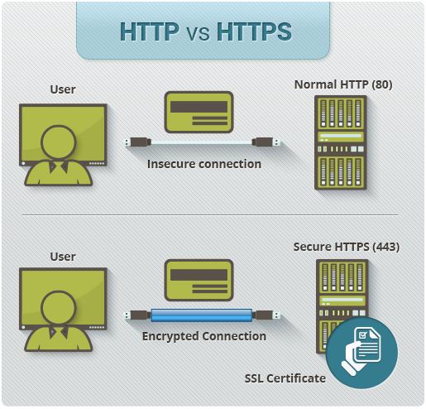
HTTP secure
https://www.instantssl.com/ssl-certificate-products/https.html

Slide 38
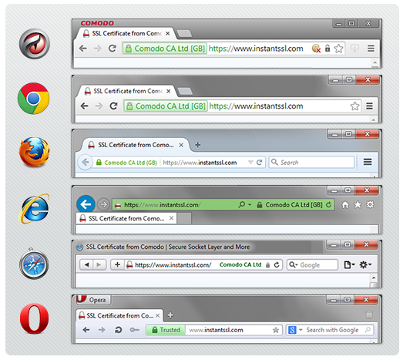
HTTP secure
https://www.instantssl.com/ssl-certificate-products/https.html

Slide 39
HTTP secure, mixed content
Many web pages show content like images, JavaScript, etc.
  Content can come from different servers
  Some of this content can be transported using https others using ordinay http
  Example
    https://www.rejsekort.dk/brug-rejsekort/her-kan-du-bruge-rejsekort/hovedstadsomraadet.aspx
  The browser warns the user, or refuses to show the unsecured content in an otherwise secure web page.

Slide 40
Chapter 8 roadmap
8.1 What is network security?
8.2 Principles of cryptography
8.3 Message integrity
8.4 Securing e-mail
8.5 Securing TCP connections: SSL
8.6 Network layer security: IPsec
8.7 Securing wireless LANs
8.8 Operational security: firewalls and IDS

Slide 41
What is network-layer confidentiality ?
between two network entities:
sending entity encrypts datagram payload, payload could be:
  TCP or UDP segment, ICMP message, OSPF message ….
all data sent from one entity to other would be hidden:
  web pages, e-mail, P2P file transfers, TCP SYN packets …
“blanket coverage”

Slide 42
Virtual Private Networks (VPNs)
motivation:
institutions often want private networks for security.
  costly: separate routers, links, DNS infrastructure.
VPN: institution’s inter-office traffic is sent over public Internet instead
  encrypted before entering public Internet
  logically separate from other traffic

Slide 43



Virtual Private Networks (VPNs)
public
Internet
laptop
w/ IPsec
IP
header
IPsec
header
Secure
payload
salesperson
in hotel
IP
header
IPsec
header
Secure
payload
IP
header
IPsec
header
Secure
payload
router w/
IPv4 and IPsec
router w/
IPv4 and IPsec
IP
header
payload
IP
header
payload
branch office
headquarters

Slide 44
Chapter 8 roadmap
8.1 What is network security?
8.2 Principles of cryptography
8.3 Message integrity
8.4 Securing e-mail
8.5 Securing TCP connections: SSL
8.6 Network layer security: IPsec
8.7 Securing wireless LANs
8.8 Operational security: firewalls and IDS

Slide 45


Firewalls
firewall
isolates organization’s internal net from larger Internet, allowing some packets to pass, blocking others
administered
network
public
Internet
trusted “good guys”
untrusted “bad guys”
firewall

Slide 46
Firewalls: why
prevent denial of service attacks:
  attacker establishes many bogus TCP connections, no resources left for “real” connections
prevent illegal modification/access of internal data
  e.g., attacker replaces CIA’s homepage with something else
allow only authorized access to inside network
  set of authenticated users/hosts
three types of firewalls:
  stateless packet filters
  stateful packet filters
  application gateways

Slide 47
Stateless packet filtering
Should arriving packet be allowed in? Departing packet let out?
internal network connected to Internet via router firewall
router filters packet-by-packet, decision to forward/drop packet based on:
  source IP address, destination IP address
  TCP/UDP source and destination port numbers
  ICMP message type
  TCP SYN and ACK bits

Slide 48
Stateless packet filtering: example
Warriors of the Net, movie 8:55
  https://www.youtube.com/watch?v=PBWhzz_Gn10
example 1: block incoming and outgoing datagrams with IP protocol field = 17 and with either source or dest port = 23
  result: all incoming, outgoing UDP flows and telnet connections are blocked
example 2: block inbound TCP segments with ACK=0.
  result: prevents external clients from making TCP connections with internal clients, but allows internal clients to connect to outside.

Slide 49
Stateless packet filtering: more examples
Policy | Firewall Setting
No outside Web access. | Drop all outgoing packets to any IP address, port 80
No incoming TCP connections, except those for institution’s public Web server only. | Drop all incoming TCP SYN packets to any IP except 130.207.244.203, port 80
Prevent Web-radios from eating up the available bandwidth. | Drop all incoming UDP packets - except DNS and router broadcasts.
Prevent your network from being used for a smurf DoS attack. | Drop all ICMP packets going to a “broadcast” address (e.g. 130.207.255.255).
Prevent your network from being tracerouted | Drop all outgoing ICMP TTL expired traffic

Slide 50
Access Control Lists
ACL: table of rules, applied top to bottom to incoming packets: (action, condition) pairs
action | source address | dest address | protocol | source port | dest port | flag bit
allow | 222.22/16 | outside of 222.22/16 | TCP | > 1023 | 80 | any
allow | outside of 222.22/16 | 222.22/16 | TCP | 80 | > 1023 | ACK
allow | 222.22/16 | outside of 222.22/16 | UDP | > 1023 | 53 | ---
allow | outside of 222.22/16 | 222.22/16 | UDP | 53 | > 1023 | ----
deny | all | all | all | all | all | all

Slide 51
Stateful packet filtering
stateless packet filter: heavy handed tool
  admits packets that “make no sense,” e.g., dest port = 80, ACK bit set, even though no TCP connection established:
action | source address | dest address | protocol | source port | dest port | flag bit
allow | outside of 222.22/16 | 222.22/16 | TCP | 80 | > 1023 | ACK
stateful packet filter: track status of every TCP connection
  track connection setup (SYN), teardown (FIN): determine whether incoming, outgoing packets “makes sense”
  timeout inactive connections at firewall: no longer admit packets

Slide 52
Stateful packet filtering
ACL augmented to indicate need to check connection state table before admitting packet
action | source address | dest address | proto | source port | dest port | flag bit | check conxion
allow | 222.22/16 | outside of 222.22/16 | TCP | > 1023 | 80 | any
allow | outside of 222.22/16 | 222.22/16 | TCP | 80 | > 1023 | ACK | x
allow | 222.22/16 | outside of 222.22/16 | UDP | > 1023 | 53 | ---
allow | outside of 222.22/16 | 222.22/16 | UDP | 53 | > 1023 | ---- | x
deny | all | all | all | all | all | all

Slide 53
Application gateways
gateway-to-remote
host telnet session
host-to-gateway
telnet session
Warriors of the net, movie 5:35
filters packets on application data as well as on IP/TCP/UDP fields.
example: allow select internal users to telnet outside.
application
gateway
router and filter
1. require all telnet users to telnet through gateway.
2. for authorized users, gateway sets up telnet connection to dest host. Gateway relays data between 2 connections
3. router filter blocks all telnet connections not originating from gateway.

Slide 54
Application gateways
filter packets on application data as well as on IP/TCP/UDP fields.
example: allow select internal users to telnet outside
host-to-gateway
telnet session
application
gateway
router and filter
gateway-to-remote
host telnet session
1. require all telnet users to telnet through gateway.
2. for authorized users, gateway sets up telnet connection to dest host. Gateway relays data between 2 connections
3. router filter blocks all telnet connections not originating from gateway.

Slide 55
Limitations of firewalls, gateways
IP spoofing: router can’t know if data “really” comes from claimed source
if multiple app’s. need special treatment, each has own app. gateway
client software must know how to contact gateway.
  e.g., must set IP address of proxy in Web browser
filters often use all or nothing policy for UDP
tradeoff: degree of communication with outside world, level of security
many highly protected sites still suffer from attacks

Slide 56
Intrusion detection systems
packet filtering:
  operates on TCP/IP headers only
  no correlation check among sessions
IDS: intrusion detection system
  deep packet inspection: look at packet contents (e.g., check character strings in packet against database of known virus, attack strings)
  examine correlation among multiple packets
    port scanning
    network mapping
    DoS attack
      http://map.norsecorp.com/

Slide 57
Intrusion detection systems
multiple IDSs: different types of checking at different locations
firewall
internal
network
Internet
IDS
sensors
Web
server
DNS
server
FTP
server
demilitarized
zone

Slide 58
Network Security (summary)
basic techniques…...
  cryptography (symmetric and public)
  message integrity
  end-point authentication
…. used in many different security scenarios
  secure email
  secure transport (SSL)
  IP sec
  802.11
operational security: firewalls and IDS

