Slide 1
Android ListViews and Adapters
Displaying lists of similar data

Slide 2
ListView
ListView is a view (GUI component) to show a list of information.
Example: StarBuzzListExample -> activity-toplevel.xml
ListView can be used with other Views in an Activity

Slide 3
ListActivity
ListActivity is a special Activity (sub-class) which contains a ListView only.
Useful if you have an Activity with a List and nothing else
Example:
StarBuzzListExample -> DrinkCatagoryActivity

Slide 4
Adding data to a ListView
Listviews can be populated from a number of different data sources:
ListView can be populated using static data from the string.xml file
Example: StarBuzzListExample -> activity-toplevel.xml
ListView can be populated from an Array or List in the application
Example: StarBuzzListExample -> DrinkCategoryActivity
To connect the ListView to the datasource we need a ListAdapter
Other data sources
Data from a database, network (REST service …), etc.

Slide 5
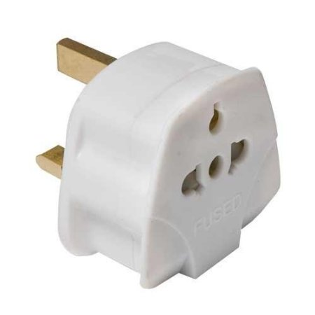
Data sources and adapters
Many different views
ListView, Spinner, etc.
Many different data sources
Adapters make the data source work with the view
Adapter responsibilities
Supply data to the List, etc.
Create a view for each List item
Source https://anujarosha.files.wordpress.com/2011/11/2-create-a-listview-using-arrayadapter-in-android.png

Slide 6
Some adapter classes
ArrayAdapter<T>
Handles arrays […] and List<T> of objects
CursorAdapter<T>
Handles results from SELECT queries to a database
CustomAdapter
Make your own adapter by extending BaseAdapter<T> or ArrayAdapter<T>
Example
StarBuzzListExample: DrinkCategoryActivity + drinklist_item.xml

Slide 7
ArrayAdapter<T> constructors
The class ArrayAdapter<T> has 6 public constructors.
We often use this
ArrayAdapter(context, resourceId, data source)
Context
The Activity object that contains the list, usually this
ResourceId
The id (int) of the layout file containing a TextView to use when instantiating views for each item in the list
Data source
An array [..] or a List<T>

Slide 8
ArrayAdapter different ways to display an item
There are several way to display an item in a list …
Android.R.layout contains some displays for list items
… and a lot of other things
Not to be confused with the R file containing your id etc.

