Slide 1
Location based services
Using Google maps etc.
in Android apps

Slide 2
Some location-based services available in Android
Showing maps
  Annotating maps
Geocoding
  Address -> location
Reverse geocoding
  Location -> address(es)
Getting live location information
  Through GPS, mobile phone cell tower triangulation, or Wi-Fi positioning

Slide 3
Google maps
Google maps are NOT part of the Google API
  It’s an add-on
  Choose Google API when you create a new Eclipse project
  Add another element to androidManifest.xml (inside the Application element)
    <uses-library android:name="com.google.android.maps" />
To use Google Maps in your Android application you must obtain a Google Maps API key from Google
Special classs com.google.android.maps.MapActivity (Map API v1) and MapFragment (Map API v2)
Example: Lee4Maps

Slide 4
Some Map related classes
MapActivity
  setBuiltInZoomControls(true)
    Show ‘-’ and ‘+’ buttons to zoom out and in
  setSatellite(true)
    Satellite view
  setStreetView(true)
    I had problems with this on (sometimes)
GeoPoint
  (latitude, longitude) in micro-degrees
    Degrees * 1E6 (aka. 1 million)
    Decimal, not sexagesimal
      Sexagesimal, degrees:minutes:seconds, used in the navy
MapController
  MapControler mc = mapActivit.getController();
  mc.animateTo(geoPoint)

Slide 5
Map overlays
Map overlays are like transparent films placed over a map.
Overlays can be annotated with different symbols, like pushpins
The class com.google.android.maps.Overlay
  Often extends as an inner class inside a MapActivity class
Some methods
  Draw(Canvas, MapView, shadow, when)
    Enables you to annotate the overlay
  onTouchEvent(MotionView, MapView)
    Called then the user clicks the overlay

Slide 6
Geocoding and reverse geocoding
Geocoder geocoder = new Geocoder(context, locale)
Geocoding
  Address -> position
  geocoder.getFromLocation(latitude, longitude, howMany)
Reverse geocoding
  Position -> Address(es)
  geocoder.getFromLocationName(location, howMany);
I had problems
  ”Service not Available” in my emulator
  Works on my phone.

Slide 7
Getting location data:
Where am I?
Some applications needs to know the current position of the user’s device.
Three ways to obtain the position
  GPS satellite
    Most accurate
  Mobile phone cell tower triangulation
    Works indoors
  Wi-Fi
    The address of the connected Wi-Fi should be known
    Least accurate
AndroidManifest.xml
  <uses-permission android:name="android.permission.ACCESS_COARSE_LOCATION" />
  <uses-permission android:name="android.permission.ACCESS_FINE_LOCATION" />

Slide 8
Location related classes and interfaces
Package: android.location
LocationManager
  Class: Provides access to Android location services
LocationListener
  Interface: Receiving notifications from LocationManager when location has changed
LocationProvider
  Abstract class: Describes a location provider, like GPS
Location
  Class: Geographic location
Example: location, Eclipse project

Slide 9
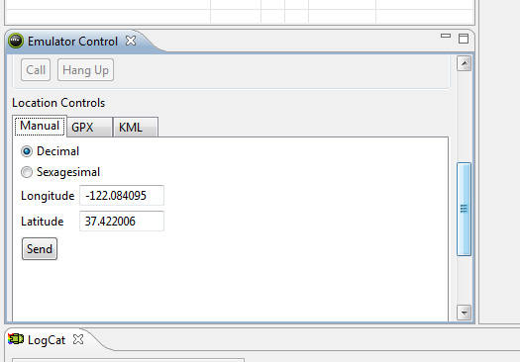
Setting locations in the emulator
Eclipse: Use the DDMS perspective
  Window -> Open Perspective -> DDMS
Emulator control tab / window
  Scroll down to ”location controls”
You can send new locations to the emulator as often as you want
  To simulate a moving device
  I had problems!!

Slide 10
Different location providers:
Pros and cons
GPS_PROVIDER
  Accurate
  Works only outdoors
    Device must have satellite connection
  Consumes battery
    Satellite connection consumes battery
  Slow
NETWORK_PROVIDER
  Less accurate
  Works indoors (Wi-Fi + cell-tower) and outdoors (cell-tower)
  Consumes less battery
  Faster
Source
  http://developer.android.com/guide/topics/location/obtaining-user-location.html

