Slide 1
Android
The Activity Life Cycle

Slide 2
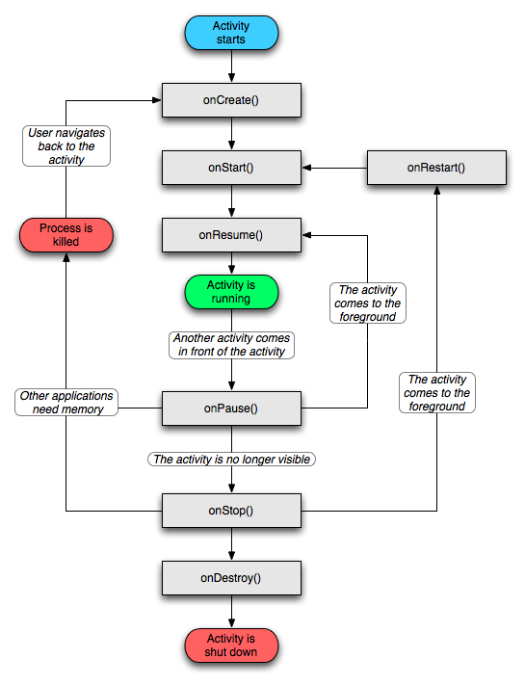
Activity life cycle
Notes:
Figure from http://developer.android.com/guide/topics/fundamentals/activities.html

Slide 3
Life cycle methods
An Activity object goes through quite an elaborate life cycle.
The Activity class defines a number of methods which are called when an object goes from one stage to another in the life cycle
  Example: LifecycleDemo
We can override the methods in our own Activity class
  Template Method design pattern
    Super class is concrete (not abstract) with lots of hook methods

Slide 4
Template method design pattern
Class Activity defines a lot of methods.
Many of these methods may be overridden by sub-classes
  So-called hook methods
The Activity class calls the methods whenever it is appropriate
  Change in lifecycle
    onCreate(), onStart(), etc.
  Other events, like
    onActivityResult()

