Slide 1
Android Fragments
A very brief introduction

Slide 2
Fragments, what and why?
Fragments are fragments(!) of an Activity.
A Fragment can be re-used in many Activities.
Fragments can help you adapt to different screen sizes and resolutions.
Most Fragments has a UI (User Interface), but some Fragments has no UI.
Fragments were introduced in Android 3.0
  Android 3.0 (API level 11) is the tablet version.

Slide 3
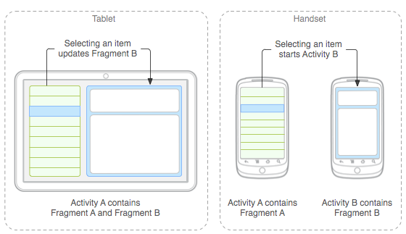
Fragments used on tablets and phones
Picture from http://developer.android.com/guide/components/fragments.html

Slide 4
Programming a Fragment
Public class MyFragment extends Fragment { … }
Fragments do not need to register in manifest.xml
  A Fragments can only be used in an application, when the Fragment is inside an Activity
The Fragments UI is defined in a layout XML file
  Just like an Activity
    Or the UI can be made programmatically (just like an Activity)
  Some Fragments might not even have a UI
    An invisible Fragment
Examples:
  FragmentExampleDateTime

Slide 5
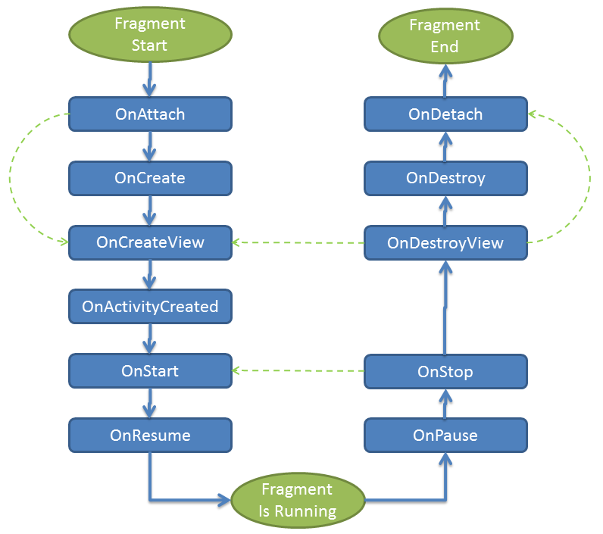
The Fragment lifecycle
The Fragment lifecycle is similar to the Activity lifecycle.
View onCreateView() is the method to override in subclasses.
  Not onCreate (unlike Activity subclasses)
http://docs.xamarin.com/guides/android/platform_features/fragments/part_1_-_creating_a_fragment/

Slide 6
Adding fragment to an Activity
Fragment can be added statically or dynamically
Statically
  Declared in the Activities layout XML file
  Example: FragmentExampleDateTime
Dynamically
  Adapt to the current screen size
    Show more fragments on bigger screens
  In the Activities Java file
  Examples
    FragmentAddDynamically
    WorkoutFragments

Slide 7
Another example: Adapting to wide screens
Example: ScreenSizeExample
Android Studio
  Project template ”Master/Detail Flow”
Master-Detail
  Wide screen: Master + detail side-by-side
  Normal screen: Master + detail i separate activities
  Different layout files
    w900dp (show project as ”Project Files”)
      Width at least 900 dp
  Try with different emulators

Slide 8
Special Fragments from the Android API
DialogFragment
  Dialog window
ListFragment
  List of items
PreferenceFragment
  User preferences
WebViewFragment
  Small web browser
MapFragment
  Shows a Google Map

Slide 9
Single Activity App
From web development
  SPA = Single Page Application
  Web application with a single page
    The page content is changed as needed
Android: Single Activity App
  Android apps with a single Activity
    The Activity content is changed as needed
    Fragments are handy …
  Example: BasicActivityActivityExample

Slide 10
References and further readings
Android Developer: Building a Dynamic UI with Fragments
  http://developer.android.com/training/basics/fragments/creating.html
Android Developer: Fragments
  http://developer.android.com/guide/components/fragments.html
Conder & Darcy: Android User Interface Design: Working With Fragments
  http://mobile.tutsplus.com/tutorials/android/android-sdk_fragments/
Xamarin: Fragments
  http://docs.xamarin.com/guides/android/platform_features/fragments/

