Slide 1
Introduction to Android

Slide 2
What is Android?
Android is a mobile operating system.
A modified version of Linux
Google bought Android from another company in 2005
Android is open source
Android comes in several versions
Updated frequently

Slide 3
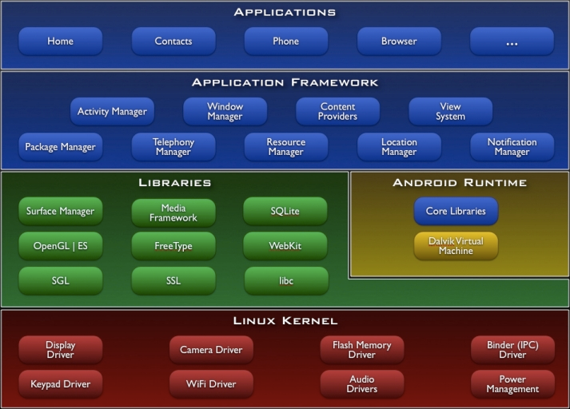
Architecture of Android
Notes:
Figure from http://developer.android.com/guide/basics/what-is-android.html

Slide 4
The necessary tools
Android SDK
Libraries, emulators, debugger, etc. specific to Android.
Android Studio
An IDE (Integrated Development Enviroment)
Emulator / Android device
Emulators, to run Android apps on a normal computer
It is better to use an Android phone, if you have one

Slide 5
Android application development with Android Studio
How to get started
Create an Android project
Choose a build target
My phone runs Android 12
I usually chose a build target older than my phone
Add a few UI components to main.xml
Override the onCreate() method in your Activity
Start the emulator / connect your Android device
Takes some time …
Run the application in the emulator
Or better, run the app on your phone

Slide 6
What’s in a Android application? Some Android Studio folders
java
Kotlin (and Java) source files.
This is where you program your Activities
res.drawable
Pictures, etc. In different resolutions (high, low, medium)
res.layout
XML files describing user interfaces
res.values.strings.xml
XML file with constant strings, like application name, etc.
AndroidManifest.xml
XML file describing the Android application

