Slide 1
Creating Android user interfaces using layouts

Slide 2
User interface defined in an XML file
Android user interfaces are usually defined in XML files in the res folder
During compilation the XML files generates a single Java class called R.
  Set in the gen (Generated Java Files) folder
Loaded in the Activity class
  setContentView(R.layout.nameOfXmlFile)

Slide 3
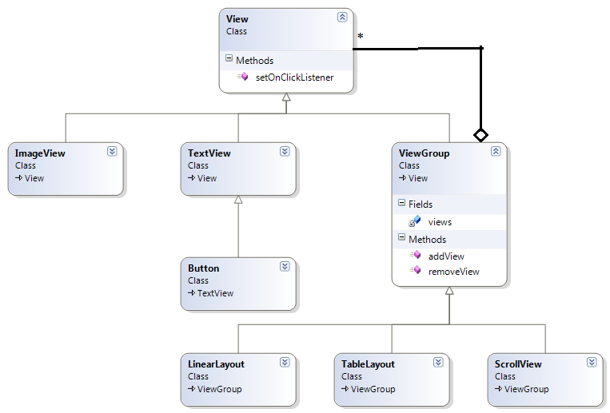
View and ViewGroup
Organized using the Composite Design Pattern
Notes:
Figure made in Microsoft Visual Studio: C:\andersb\android\AndroidViewClassDiagram. How to make an aggretation (from ViewGroup to View) in the class diagram?

Slide 4
Screen densities
Low density (ldpi): 120 dpi
Medium density (mdpi): 160 dpi
High density (hdpi): 240 dpi
Extra high density (xhdpi): 320 dpi
Used for units of measurement
Used for pictures, icons, etc.
  /res/drawableXx in your Android projects

Slide 5
Units of measurement
Views sometimes needs measurements
Some units of measurement
  dp: density-independent pixel
    160dp screen: 1dp ~ 1 pixel.
    Other screen densities: Scales automatically
    Recommended for specifying dimension of views
  sp: scale-independent pixel
    Similar to dp, but scaled by users font preferences
    Recommended for specifying font sizes
  pt: point
    72pt = 1 inch = 2.54 cm on the physical screen
  px: pixel
    Corresponds to the actual pixels on the screen.
    Not recommended, as the user interface may render differently on devices with different screen sizes
  in: inches
    Not recommended
  mm: millimeters
    Not recommended
  Example: unitsOfMeasureMent
  Source http://developer.android.com/guide/topics/resources/more-resources.html#Dimension

Slide 6
Different layouts
LinearLayout
  Horizontal or vertical
AbsoluteLayout
  Not recommended
TableLayout
  Table with rows and columns
RelativeLayout
  Child elements are positioned relative to each other
FrameLayout
  Placeholder to display a single view + title, etc.
ScrollView
  Enables the user to scroll through a list of views

Slide 7
Some XML view attributes
Used in the layout XML files
  android:id="@+id/number1”
    The view is identified by this id.
    Used in the Java code
      EditText number1field = (EditText) findViewById(R.id.number1);
  android:layout-width=”fill_parent”
    The view will take as much space as the parent view allows.
    Renamed “match_parent” in API level 8
  android:layout-height=”wrap_content”
    The view will take as much space as needed to wrap the child (content) views
  android:text=”some text”
    Sets a text in the view
    The text should be specified in the file /res/values/strings.xml for easy internationalization and localization.

Slide 8
Display orientation
Most Android devices have two display orientation
  Portrait
  Landscape
  Switch as you turn the phone
The emulators can also switch display orientation
  Ordinary emulators: Press Ctrl + F11
  Geny Motion: use the “rotating phone” icon (right side)
  Wait a moment for the layout to adapt to the new orientation

Slide 9
Adapting to display orientation
The onCreate() method is called whenever the display orientation changes
  This gives your a chance to adapt to the new orientation
Two techniques to handle changes in display orientation
  Anchoring
    Anchor you views to the four edges of the display
  Resizing and repositioning
    Resize views according to the display orientation

Slide 10
Resizing and Repositioning
Make two layout XML files for each Activity
  Layout for portrait orientation
    In the folder layout
  Layout for landscape orientation
    In the folder layout-land
    Both layout folders must be in the res folder
    Example: unitsOfMeasurement + LayoutOrientation
Notes:
Page 101

Slide 11
Changing display orientation means loss of state
Changing display orientation destroys and then recreates the activity
  The activity’s state is lost
Named views (android:id) will have their state persisted
Other fields can be persisted using the methods
  onSaveInstanceState(Bundle outState)
    Save the values in the Bundle
  onRestoreInstanceState(Bundle savedInstanceState)
    Values from Bundle used to restore field values
Example: collectWords
Notes:
Lee page 104 + 108 top

Slide 12
Controlling the display orientation
Programmatically in the onCreate() method
  setRequestedOrientation( ActivityInfo.SCREEN_ORIENTATION_LANDSCAPE );
Declaratively in the activity element of AndroidManifest.xml
  android:screenOrientation=”landscape” on the activity element
    Example: collectWords
  Documentation
    http://developer.android.com/guide/topics/manifest/activity-element.html#screen
Notes:
Lee page 110

Slide 13
Creating the User Interface Programmatically
Usually and Activity’s user interface is defined in an XML file
  Declaratively: Set at compile time
However, the user interface can also be create in Java in the onCreate() method
  Programmatically: Set at run-time
  Very much like Java Swing
    Create a layout object
    Create View objects like Button, TextView, etc. objects with their own layout parameters
    Add the view objects to the Activity
    Add the layout object to the Activity
Combination
  Parts of the GUI is declared (the layout, etc.). Others parts are created programmatically
Example:
  LayoutProgramatically
Notes:
Lee page 111. Example: LeeLayoutProgrammaticallyPage111

