Slide 1
HOW TO Upload your Dissertation to Fronter
Autumn 2014

Slide 2
Upload to Fronter
You hand in your dissertation by uploading a .zip file to Fronter (details follow)
You can upload your Dissertation from now, until January 8th, 11.00 (AND NO LATER)
Until the deadline expires, you can upload, delete, and upload again…

Slide 3
Upload to Fronter
You upload ONE single .zip file to Fronter
All text material must be handed in in .pdf format
The .zip file must be named according to the following principle: First name, Last name and date of birth in the following format:
”First nameLast nameDDMMYYYY.zip”. For example: JohnAndersson08061990.zip. Now the file can be placed in the folder for hand in.
Are you a group who hands in together, one person in the group must be in charge of the hand in according to the principles above.

Slide 4
Upload to Fronter
Choose a file structure which makes it as easy as possible to find the relevant material (name folders appropriately, etc..)
Good idea to include a short guide to your material

Slide 5
Where to Upload
Go to www.fronter.com/easj
Use your UNI-login to log in:

Slide 6
Where to Upload

Slide 7
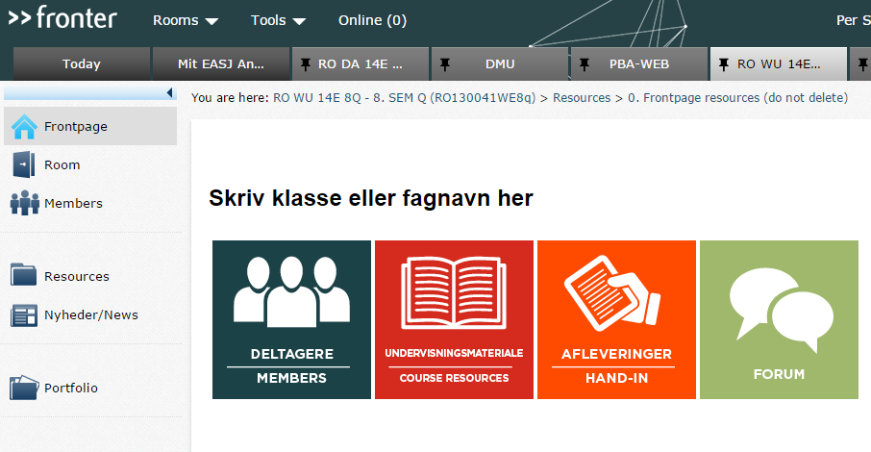
Where to Upload
Go to the ”room” for 8.semester PBA WEB

Slide 8
Where to Upload
Go to ”Resources”

Slide 9
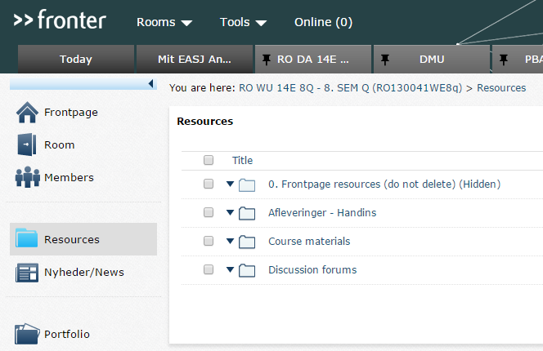
Where to Upload
Go to ”Afleveringer - Handins”

Slide 10
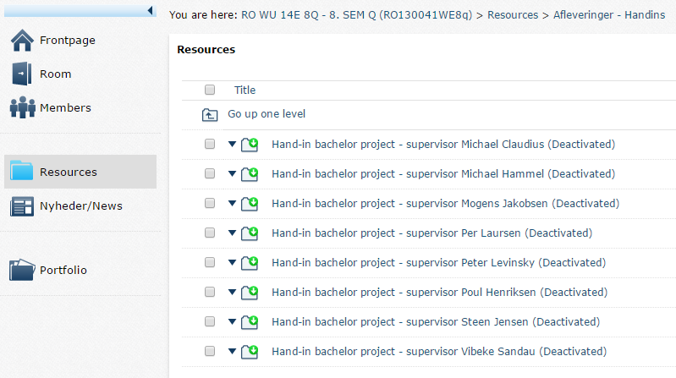
Where to Upload
Go into the folder of your supervisor!

Slide 11
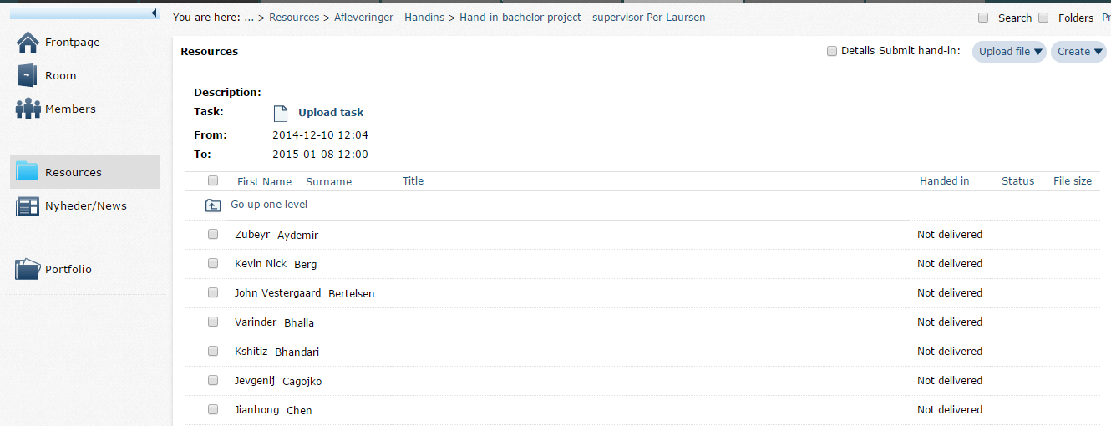
Where to Upload
Click on ”Upload file”
Tick off your name (or all names of those in your group)

Slide 12
Where to Upload
Choose your .zip file – also fill out the Title field, with same Title as file name
Click on Save – you are done ☺

Slide 13
Where to Upload
Note that it is YOUR RESPONSIBILITY to check that the file has been properly uploaded!
In case of illness you have to send a doctor’s declaration to the programme secretary (Jette Bech – JeBe@easj.dk ) to prove your illness. You have to pay for the doctor’s declaration yourself.
If the examination paper is not handed in during the period, in which the folder for hand in is open, we will consider the paper as not handed in.

