Slide 1
Dissertation Course – Day 2

Slide 2
Day 2(+3): ”Further into the details”
  An excellent dissertation project
  Method
  Your problem definition
  Your method
  Planning and prioritization
  Objectivity vs. Subjectivity
  Supporting claims
  Walkthrough of ”Dissertation Writing…”
  Language and wording
  Reflection
  …also time allocated for match-making

Slide 3
Day 4: ”The End is near”
  Group status and problems (”workshop”)
  Using sources
  Writing proper conclusions
  Report structure and layout
  The exam

Slide 4
An excellent dissertation project

Slide 5
Excellent dissertation project
Knowledge
Skills
Competences
Curriclum section 7 + 17
http://zibat.dk/wp-content/uploads/2015/06/Curriculum-Computer-Science.pdf

Slide 6
  Method

Slide 7
Method
Before:
  Decide the focus area(s) for your dissertation project
  Make a good problem definition
Method:
  Decide what to do in order to answer the problem definition question(s)
  Make a plan (order of the activities) for your dissertation project

Slide 8
Method
Activities may include
  Study relevant literature
  Study technology
  Characterize systems development project and decide systems development methodology
  Do a scientific investigation
  Do a business analysis
  Develop a software system
  Programming
  Find and describe a framework for comparison of …
  Etc. Etc.

Slide 9
Example 1
4. Problem definition
By doing this project I want to learn how to develop dynamic web application with Java Server Faces components and Java studio creator.
Java Server Faces is a set rich web application user interface library. And I chose web program as my elective course topic in 4th semester, it is a good chance to extend my knowledge which I am interested in.
Java studio creator is a suitable tool for developing web application.
.
.
5.1.2 Activities overview
I will follow this order to achieve my iteration objective:
Develop Software Requirement Specifications
Develop Risk List
Develop Use Cases Model
Develop Iteration Plan
.

Slide 10
Example 1
Is it a good problem definition?
Why? / why not?
Are the activities mentioned sufficient?
Reformulate the problem definition
Give examples of more activities needed.

Slide 11
Example 2
4. Problem formulation
Since few years web shop business is growing very fast. It has been main attraction for some business investor as well as typical average people. Brokers who manage to find customer and seller can make money out of the transaction. But it is not the optimum way of handling this kind of transaction. We are living in the age of information technology where we suppose to easily get enough information as we need.
Customers face problems of without category food, delivery or take away time, payment options and order confirmation.
4.1 Research questions
This project is developed to solve following questions.
• What is the advantage and disadvantage between ‘Real Shop’ and ‘Webshop’?
• How to build web shop and choose right CMS system?
• How to make a better website to responsive design and enhance users interface developed?
• Which functions are most important and could be best used in this project?
• How can we gain user faith?
• What does my client want for their website?
• What kind of design style should I create for home page, product page, shipping option, payment option etc.?
• Which E-commerce CMS tools, technology, Shipping module, Payment Module should I use?
• How can I manage the web developing process (or Develop cycle)?

Slide 12
Example 2
Is it a good problem definition?
Why? / why not
Suggest method and activities

Slide 13
Example 3 – problem definition
What is Behaviour Driven Development and which are its underlying assumptions?
What are the benefits when developers use Behavior Driven Development?
What is behaviour driven development in a methodology perspective?

Slide 14
Example 3 - method
Study literature on TDD and BDD
Describe theory on Test Driven Development
Describe Behaviour Driven Development in theory and practice
Find and collect experiences from companys using BDD
Develop questionaire on BDD
Interview companies
Develop an application using BDD
Study literature on methodologies
Find out if BDD is a methodology

Slide 15
Example 3
Is it a good problem definition?
Why? / why not
Suggest method and activities

Slide 16
Exercise
Work on your
  Problem definition
  Method (set of activities)

Slide 17

  Planning and Prioritization

Slide 18
Planning
Before:
  Decide the focus area(s) for your dissertation project
  Make a good problem definition
Method:
  Decide what to do in order to answer the problem definition question(s)
  Make a plan (order of the activities) for your dissertation project

Slide 19
Planning
Project plan: 1-dimensional
Project start
Project establishment
Problem definition and method finished
Problem Solving
Project end
Finish report
Project hand-in

Slide 20
Planning
Phase/step/iteration plan: 2-dimensional
Made per phase/step/iteration
activities
Decide focus area
Write problem definition
Decide method
Make plan
Etc………….
time

Slide 21
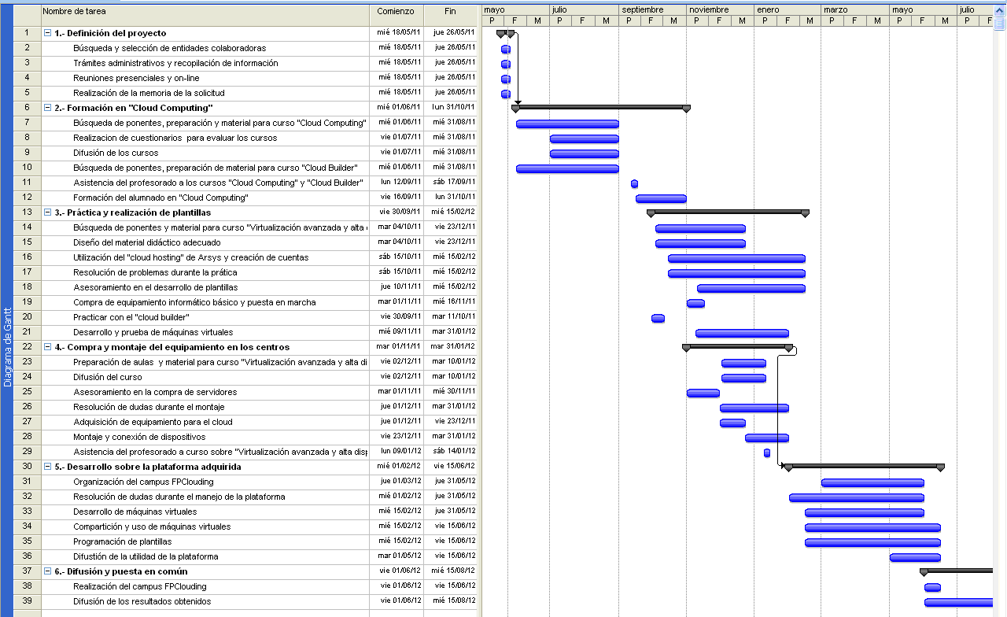
MS-Project

Slide 22
Planning
Early and often!!
Estimate and prioritize!
  Time is limited
  Make sure to prioritize (ask user, if any)
    Requirements for a systems development project, e.g.:
      Critical
      Important
      Nice to have
    Relevant aspects for a theoretical project

Slide 23
Report: Table of contents
Now you can begin your report table of content.
The activities from the plan must be reflected in the table of contents
  If you plan to do something, but don’t write about in the report, then the reader does not know
The sections from the table of contents must be reflected in the plan
  You cannot write about something you did not plan
OBS Report sequence does not have to be the same as the plan’s sequence

Slide 24
Exercise
Make a first plan
Make a first table of contents for the future report.

Slide 25
  Objectivity vs. Subjectivity

Slide 26
An attempt to define Objectivity and Subjectivity
Objective is a statement that is completely unbiased. It is not touched by the speaker’s previous experiences or tastes. It is verifiable by looking up facts or performing mathematical calculations.
Subjective is a statement that has been colored by the character of the speaker or writer. It often has a basis in reality, but reflects the perspective through the speaker views reality. It cannot be verified using concrete facts and figures
Source: www.differencebetween.net

Slide 27
In any sort of scientific work, we strive at obtaining facts
Facts are objective statements, supported by data (we return to facts later…)
A dissertation is considered a scientific work, and must therefore produce facts
It should, however, be possible to verify whether an objective statement is true or false.

Slide 28
Examples of facts (or are they…?):
  1 + 1 = 2
  The Earth has one moon
  Men are on average taller than women
  Denmark is a wealthier country than Congo

Slide 29
When does a statement become a fact?
Without any data supporting the statement, the statement is just a claim
Claim + Data = Fact

Slide 30
This principle applies to all aspects of your entire dissertation!
You cannot use claims to make important decisions; it must be facts!
Even though you know something is a fact (how do you know that…?), you must also be sure to present it as a fact (include data)

Slide 31
”The users found it to be too complicated to make new entries into the blog section of the website, so we will redesign it…”
”The users found the redesigned blog section much easier to use…”

Slide 32
”We succeded in creating an application that fulfills all of the user’s requirements…the user was therefore very satisfied with the final application”

Slide 33
Are statements like the below then useless?
”The new version of the application must be significantly faster than the existing application”

Slide 34
”The new version of the application must be significantly faster than the existing application”
Here are 17 test cases – for the new version, it must hold that:
  No test case has longer running time on the new version
  The average running time – when running all test cases – of the new version must be at least 20 % below the average running time of the existing version

Slide 35
A subjective statement should be broken down into a number of objective (and thus verifiable) statements
  Subjective claim ->
  Set of objective claims ->
  Obtain data to verify claims ->
  Set of objective facts ->
  ”Subjective fact” (according to how we broke down the subjectivity)

Slide 36
Exercise
How would you convert the statement ”Many people in Africa are poor” into an objective statement?

Slide 37
  Supporting Claims

Slide 38
When does a statement become a fact?
Without any data supporting the statement, the statement is just a claim
Claim + Data = Fact
This statement is in itself a claim…

Slide 39
How do we KNOW something?

Slide 40
”More people live in China than in India”
”How do you know this…?”
”My Geography teacher told me…”

Slide 41
”More people live in China than in India”
”How do you know this…?”
”It says so on Wikipedia…”
(http://en.wikipedia.org/wiki/World_population)

Slide 42
”More people live in China than in India”
”How do you know this…?”
”Well, I went to Wikipedia, followed a number of links to various sources, and all of these sources agreed that the above statement is true”
  Wikiepedia is a starting point, but not the main/only source

Slide 43
We KNOW – in the sense that we can use it as a basis for decisions – something if it is
  Common knowledge (even this is a grey area…)
  Stated to be true by an authoritative/trustworthy source
And (sigh…) what is then an authoritative and trustworthy source…?

Slide 44
NO ABSOLUTE RULES for when a source is authoritative and trustworthy
In practice, probably like Google’s page ranking algorithm: A website is trustworthy if many other websites refer to it
There are some guidelines for evaluating a source
Taken from (http://daphne.palomar.edu/handbook/support.htm)

Slide 45
Source Tests
  Specific Reference to Source: Does the writer indicate the particular individual or group making the statements used for evidence? Does the writer tell you enough about the source that you could easily find it yourself?
  Qualifications of the Source: Does the writer give you reason to believe that the source is competent and well informed in the area in question?
  Bias of the Source: Even if expert, is the source likely to be biased on the question? Could we easily predict the source’s position merely from a knowledge of his job, her political party, or organizations she works for?
  Factual Support: Does the source offer factual support for the position taken or simply state conclusions?

Slide 46
It is EXTREMELY difficult to justify beyond ANY doubt that something is true
Use the techniques described, and then make the decision you find is best…
…but remember to discuss the validity of your facts and sources

Slide 47
Exercise
What data would you gather to support the claim ”The users found that the website was not user-friendly enough”?

Slide 48
Exercise
What data would you gather to support the claim ”E-business is becoming more and more widespread in the world today”?
Also feel free to actually find some data!

