Slide 1
Kotlin and Android
A brief introduction to Kotlin

Slide 2
Kotlin, vs Java
Java
Kotlin
1995, Sun Microsystems (now Oracle)
Object-oriented
Statically typed
Inspired by C++
Large island in Indonesia
  139.000 km^2
  145.000.000 inhabitants
2016, JetBrains (Android Studio, ReSharper, etc.)
Object-oriented
Statically typed
Inspired by Scala
Small island near Saint Petersburg, Russia
  15 km^2
  43.000 inhabitants

Slide 3
Kotlin programming language, design goals
Concise:
  Reduce the amount of code
Safe
  No more NullPointerExceptions
  Val name = data?.getStringExtra(NAME)
    Example: KotlinPersonalInfo -> MainActivity
Interoperable
  Use existing libraries for JVM (like Android API)
  Compile to JVM or JavaScript
Tool-friendly
  Support for the programmer using editors (like Android Studio)

Slide 4
Kotlin, a little syntax
Semicolons are optional
  Adding a new-line is generally enough
Variables and constants
  var name = ”Anders” // variable
    Var means ”variable”
  val name2 = ”Anders” // read-only (constant)
    Val means ”value”
  Types are not specified explicity by the programmer
    Types are infered by the compiler
Examples
  KotlinCollectWords, Calculator, Personal Information

Slide 5
Kotlin, and Android
2017 Google supports Kotlin as a programming language for the Android platform
Kotlin or Java
  For each Activity you use either Java or Kotlin
  XML layout files are still used

Slide 6
Kotlin: Android, no more findVievById(…)
Import kotlinx.android.synthetic.main.activity_main.*
  activity_main.xml is the name of the layout file
var word = mainWordEditText.text
  mainWordEditText is the id from the layout file
mainClearWordsButton.setOnClickListener { /*do something*/ }
  mainClearWordsButton is the id from the layout file
Example
  KotlinCollectWords

Slide 7
Kotlin: Android event handlers
onClick in layout XML file
  Does not work
Assign an id to the Button in the layout XML file
mainClearWordsButton.setOnClickListener { /*do something*/ }
  mainClearWordsButton is the id from the layout file

Slide 8
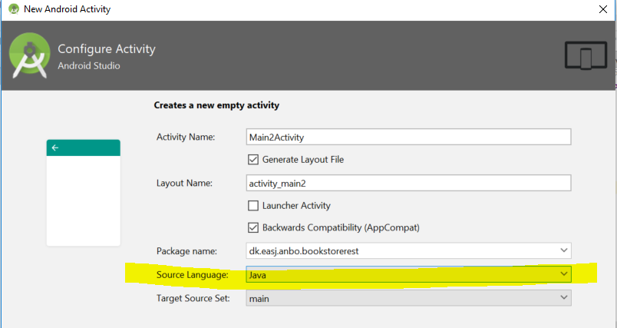
Kotlin support in Android Studio
Kotlin + Android Studio both made by JetBrains
Great support for Kotlin in Android Studio
New project
  Choose if you want to add support for Kotlin
New Activity
  Choose if you want Java or Kotlin (scroll down)
Convert existing Java code to Kotlin
  Code -> Convert Java File to Kotlin
Add Kotlin to an existing project (without support for Kotlin)

Slide 9
Anko library
Library to build Android UI in Kotlin
  And a lot more
https://github.com/Kotlin/anko

