Slide 1
Distributed architectures
A very brief overview

Slide 2
Layers / Tiers
An application is often divided into layers.
The layers might be on different hosts connected by a network
The layers are often called Tiers, then
Example
2sem: Application - Database
Browser – Web/application server (middle tier) - Database
http://www.guidanceshare.com/wiki/Application_Architecture_Guide_-_Chapter_9_-_Layers_and_Tiers

Slide 3
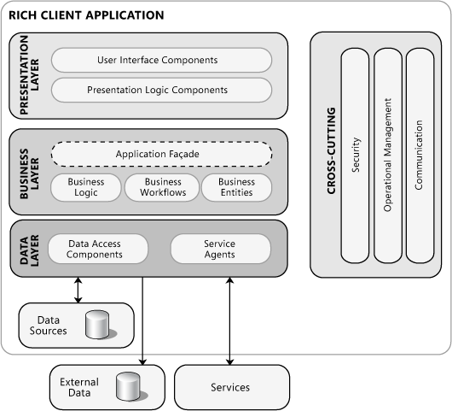
Example Rich/Fat/Thick applications
https://msdn.microsoft.com/en-us/library/ee658104.aspx

Slide 4
Example Mobile applications
https://msdn.microsoft.com/en-us/library/ee658104.aspx

Slide 5
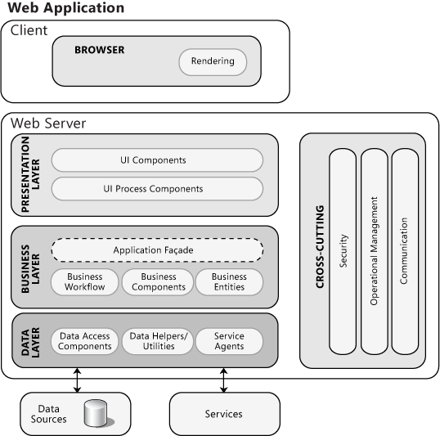
Example Web /Thin applications
https://msdn.microsoft.com/en-us/library/ee658104.aspx

Slide 6
Three types of distribution
Client servers
Peer to peer
pipelines

Slide 7
Client-Server
Server
Client
Always on
Welknown address (host + port)
TCP
Waits for incoming client connections
UDP
Waits for incomming client request
Takes the initiative
TCP
Connects to the server
UDP
Send request (Datagram) to receiver / server

Slide 8
SOAP a twist of Client-Server
Provider
Client
Always on
Welknown address (host + port)
Provide the service by the WSDL-file
Wait for a method call (from consumer)
All calls are stateless
Implements the wsdl-file
Take the initiative – make the method call

Slide 9
REST another twist of Client-Server
Restfull-service
Client
Always on
Welknown address (host + port)
Provide the service by the URL
Wait for a call to a specific URL
All calls are stateless
Take the initiative
make the call by using the url
The call uses the HTTP methods GET, PUT, POST, DELETE

Slide 10
Pipeline: Pipes and filters
A filter read input from a pipe, process the input, and writes it to another source
Data flows from filter to filter
Never backwards
Like an assembly line in a factory
Filters may be on different hosts.
Pipes are network connections
Dragging or pushing data through the filters
http://social.technet.microsoft.com/wiki/contents/articles/7244.sharepoint-2010-customize-fast-search-to-crawl-related-data-lookup-columns.aspx

Slide 11
Peer-to-Peer
Peers are equal
Peers may come and go
Each peer play the role of both a client and a server.
The client part connects to another peer’s server part and asks for service
General problem
How do peers find each other?
Solution 1: Mixed architecture
Registry / Index / Repository has information on location of peers
A server !
Solution 2: Pure distributed system
No registry …

