Slide 1
Version control
Using Git

Slide 2
What is version control?
Management of changes to documents over time
Text documents in general
Program source code and documentation
Simple version control
Multiple copies of the files labeled with (revision) numbers or dates (timestamp)
Requires discipline from the programmers
Other names
Revision control
Source control
Version management system

Slide 3
Graph structure
Revision
After a change there is a new revision of the documents
Trunk
The main development line
Branch
Work on a copy of the documents
Check out forms a new branch
Merge
Branch is merged with the original documents.
Done at check in
Concurrency problems may require manual intervention
Tag / baseline / label
Snapshot of the documents
HEAD / tip
The latest revision
Source http://e.wikipedia.org/wiki/Revision_control

Slide 4
Version control: Some important concepts
Repository
The documents are kept in a repository
Repository can be either central or distributed
Check out
To modify the documents you must check out the documents from the repository.
You get a local copy, called ”working copy”
Check in / commit
After modification you must check in the documents.
Files may be locked from check out to check in
Otherwise there might be concurrency problems

Slide 5
Check in and check out from repository
Figure from Sommerville Software Engineering, 9th edition, page 692

Slide 6
Some version control systems
Subversion from Apache
Mercurial
Team Foundation from Microsoft
http://msdn.microsoft.com/en-us/vstudio/ff637362.aspx
Git
Git is a distributed version control system
Started by Linus Torvalds (Linux), 2005
Git can be used from Visual Studio
And other development environments

Slide 7
Git, a distributed version control system
Most version control systems are centralized
There is a single remote repository
You must be online to commit, etc.
Git is a distributed version control system
Remote repository
Local repository
You commit to the local repository

Slide 8
Git: Working with a local repository
Create a local repository
Commit to the local repository
This should be done very often.
Create a branch
Checkout a branch
Merge branches

Slide 9
Git Extensions
Git Extensions is a GUI program that help you working with Git.
Git Extensions also provides a plugin for Visual Studio for the simple uses of Git.
Automatically added to Visual Studio when you install Git Extensions
Reference
https://code.google.com/p/gitextensions/
https://git-extensions-documentation.readthedocs.org/en/latest/integration.html#visual-studio

Slide 10
Working with Git Extension in Visual Studio
On your current project
Git -> Initialize new repository
This will create a local repository on your harddisk
Now you can commit your work to the local repository
Use the small green button
You should commit after you have tested your code.

Slide 11
Branching
When you want to do something with you software
Examples: Add a new feature, correct an error, or do a refactoring
You leave the original version of application
You create a new branch, and work on that branch
Later when you have tested that the new branch is working, you merge the branch with the original version of the application.

Slide 12
Merging
Merging two branches to form a single branch.
Simple scenario
Branch of from the original
Work on the new branch
Merge
Complex scenario
Branch of from the original
Work on the new branch
Work on the original
Merge: There might be conflicts to resolve (manually)

Slide 13
Working with a remote Git repository
Source http://thkoch2001.github.com/whygitisbetter/#everything-is-local

Slide 14
Working with a remote repository Figure from http://git-scm.com/book/en/Distributed-Git-Contributing-to-a-Project

Slide 15
Hosting a remote repository
A remote Git repository must be hosted on a Git repository server
https://github.com/
https://bitbucket.org/
Alternatively you can setup your own Git repository server
How to get started
Create a new remote repository
Push your project from the local repository the remote repository

Slide 16
Creating a remote repository
In GitHub create a new repository
Create a new project in Visual Studio
Commit + push the project to GitHub
All project files are pushed
Add a .gitignore file to your Visual Studio project.
Commit + push the project to GitHub
Future pushes will not include the ignored files
Now you can start working
Commit to your local repository
Push to your remote repository

Slide 17
Working with a remote Git repository
Multiple users can share a remote Git repository
Clone (copy) the project from the remote repository to a local repository
Work + commit to the local repository
Pull the original project from the remote server, into another branch in the local repository
Merge the 2 branches in the local repository
Merge happens on the local computer, not remotely
Push the project from the local repository to the remote repository
There are other (more advanced) ways to work using a remote Git repository

Slide 18
GitHub, a few hints
Make sure you use the HTTP URL Read+Write access
https://github.com/andersbor/myfirst.git
Not the Read-only URL
git://github.com/andersbor/myfirst.git
Restrictions + collaborators
In the tab ”Settings” you can ”Restrict edits to Collaborators only”.
You must then explicitly invite collaborators

Slide 19
Git support many different work flows
Simple feature branch work flow
Advanced release work flow

Slide 20
Versions control as part of configuration management
Configuration management of software systems involves four activities
Change management
Keep track of request for changes from customers and developers
Version management
Keeping track of multiple version of system components
System Building
Process of assembling program components into an executable system
Release Management
Preparing software for external release, and keeping tack of system versions released for customer use
Source: Sommerville Software Engineering, 9th edition, Pearson 2011
Chapter 25 Configuration Management, page 681-704

Slide 21
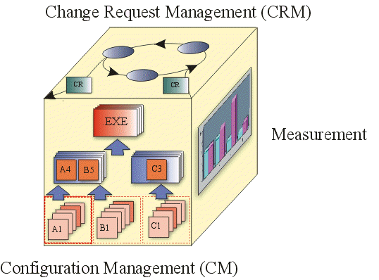
Configuration and change management in Unified Process (UP)
Configuration and Change Management is a discipline in Unified Process (UP)
Figure from http://www.upedu.org/process/discplns/conf_mgt/in_cm.htm

Slide 22
References and further readings
Wikipedia Revision control
http://en.wikipedia.org/wiki/Revision_control
Git, fast version control http://git-scm.com/
Wikipedia Git
http://en.wikipedia.org/wiki/Git_%28software%29
Git Extensions
https://code.google.com/p/gitextensions/
Faruk’s Blog Using Git as source control provider, November 24, 2013
http://farukinfo.wordpress.com/
Ian Sommerville Software Engineering, 9th edition, Pearson 2011
Chapter 25 Configuration Management, page 681-704

