Slide 1
WCF in Azure
SOAP web services in Microsoft Azure

Slide 2
Pre-conditions
Visual Studio
  You have recent version Visual Studio
    I am not sure which edition is required …
Microsoft Azure
  You have a Microsoft Azure account
    Or get one through Microsoft Imagine http://imagine.easj.dk

Slide 3
WCF
WCF = Windows Communication Foundation
Microsoft framework for building web services, etc.
We use WCF to program web services

Slide 4
Getting started: Visual Studio
Open Visual Studio
Create a new project
  Templates -> Visual C# -> WCF -> WCF Service Application

Slide 5
Getting started: Visual Studio
The files you got
Your project, some interesting files
  IService1.cs
    The interface describing the service.
    This is the public interface to the service
  Service1.svc.cs
    This is the implementation of the interface
  Web.config
    XML file containing configurations for you service

Slide 6
Develop and try the service locally
Develop and try the service locally before deploying to Azure
  Deploying the service to Azure takes a lot of time.
  Deploying to the local Azure emulator is much faster.
  Later when you have (finished) developing your server, you deploy the service to Azure
Running the service from Visual Studio
  Press run Ctrl-F5
    Compiles etc. and runs the application on top of your local IIS
      IIS = Internet Information Service (Microsoft’s web server)
    Interface in focus
      Opens a browser from where you can copy the WSDL URL to generate a service consumer
      Click Service1.svc
    Class in focus
      Opens WcfTestClient

Slide 7
Development cycle
Development cycle
  Service provider
    Add method to interface [OperationContract]
    Implement the method
    Run Ctrl-F5
  Consumer: Console application, Unit test, or …
    Refresh service reference
    Call the new method in the application

Slide 8
Server side exceptions
The server side methods may throw exceptions.
On the client side the exception becomes an instance of System.Service.FaultException.
If the client side should have more information about the exception, like the Message property …
The server side, Web.config add to the <behavior> element
  <serviceDebug includeExceptionDetailInFaults="true"/>
Reference
  http://www.codeproject.com/Articles/555415/A-Beginners-Tutorial-for-Understanding-Exception-H

Slide 9
Getting started: Azure
Log in to Microsoft Azure:
  manage.windowsazure.com the classic portal to Azure
  portal.azure.com, the new portal to Azure
  Now you need your username + password for Azure
Create a new cloud service with portal.azure.com
  Click “New”
    Top-Left, green cross
  Chose “Web + Mobild”
  Chose “App Service”
  Enter a DNS Name for your service
    I name my services anboN
      anbo referes to my name
      N is a serial number: The same as I used for my Visual Studio solution
    The full name of the service will be anboN.cloudapp.net
  Chose a resource group + Location
    Select one that is geographically close to your location
  Press “Create”
    Blue button a the bottom of the screen
    This will create the service (be patient)
Now you have an empty service

Slide 10
Publish your service in Azure
Back to Visual Studio
Sign in to Visual Studio (top right)
  Same username + password as for the Azure account
Right click your project
  Chose “Publish”
    Problems? You may have to re-install Azure SDK
  The first time you publish you must login to Azure and tell which Azure service you want to publish to
  You must also have a storage account: Create one if you don’t have one
  You project is compiled + uploaded to Azure
    Be patient!!
Find the URI of you new service
  In Azure Portal locate your service
  Click the “Site URL”
    Mine is http://anboN.cloudapp.net/
    You should get a directory listing of your service, etc.
    Click the file named Service1.svc
    You will see a reference for at WDSL file
    Mine is http://anboN.cloudapp.net/Service1.svc?wsdl THIS IT IT!
      Copy the URI

Slide 11
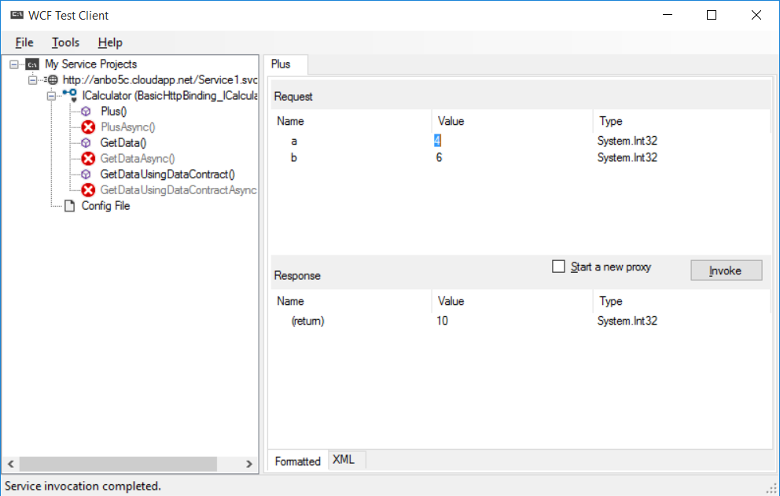
Try the WCF service with WcfTestClient
Simple application to send request to a WCF service
  Add a Service (WSDL reference)
    File menu, top left
  You send a request and receive a response
  You can watch the SOAP documents exchanged
    XML tab at the bottom of the screen
On my computer it is in the folder
  C:\Program Files (x86)\Microsoft Visual Studio 14.0\Common7\IDE

Slide 12
Make a client application
Make another Visual Studio solution
  Type: Console Application or …
  Name the solution WindowsCloudServiceConsumerN
    N is the serial number …
Make a reference from the Visual Studio project to the Azure service
  In the “Solution explorer” right click “References”
    Chose “Add Service Reference”
    In the dialog enter the URI you copied from Azure Portal
    Visual Studio now connects to Azure and downloads the WSDL file
    From the WSDL file Visual Studio generates a number of classes
Use the classes in your application
using (Service1Client client = new Service1Client())
{
String result = client.GetData(14593);
Console.WriteLine(result);
}

