Slide 1
Web services
Implementing a service-oriented architecture using SOAP

Slide 2
SOA = Service-Oriented Architecture
Nodes in a network make resources available to other participants in the network as services
Accessed in a standardized way
Loosely coupled services
Platform independent
Programming language independent
Web services makes SOA happen!

Slide 3
SOA terms
Service
  Business function
  Accepts requests, produces responses
Provider
  Function which performs a service in response to a request from a consumer
Consumer
  Function which consumes the result of a service supplied by a provider
Discovery
  Ability to identify services
  Using a repository / registry
Binding
  Relationship between provider and consumer is dynamic
    Established at runtime

Slide 4
Web services: The idea
Technology that allows applications to communicate
  Platform independent
  Programming language independent
  Send XML messages
  Can use many transport protocols
  Uses open standards
Web services are
  Developed by technical people
  Aggregated into solving business problems by business people

Slide 5
Web services, standards
Open standards defined by
  W3C http://www.w3.org
Supported by any major company
  Microsoft
  IBM
  Oracle
  and many others

Slide 6
Web services, technologies
SOAP
  Simple Object Access Protocol
WSDL
  Web Service Description Language
UDDI
  Universal Description, Discovery, and Integration
XML
  eXtensible Markup Language
  Used by all web service technologies

Slide 7
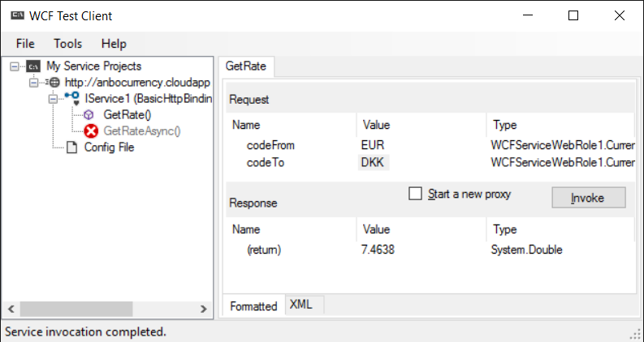
Consuming SOAP services with WCF Test Client
With WCF Test Client you can easily try a SOAP service
  Add a reference to a WSDL file
  Start calling the methods of the service
You get WCF Test Client when you download and install Visual Studio
On my computer WcfTestclient.exe is in the folder
  C:\Program Files (x86)\Microsoft Visual Studio 14.0\Common7\IDE
  Add a link to your desktop

Slide 8
Consuming SOAP web services in Visual Studio
Make a Visual Studio project
Find an interesting WSDL file
  Google “currency converter WSDL”
Add a service reference to you project
  Just insert the WSDL file URL
  Visual Studio will no generate some stub classes
Use the generated stub classes from your application
  When you call a method the stub class will create a socket, send a request, receive a response, and present the response to your application.
Example: Currency converter

Slide 9
SOAP: Simple Object Access Protocol
XML is fine for data exchange, but it’s not enough
  We need distinction between the header and the body of the message
    Like in HTTP
A SOAP message in an XML document consisting of
  Envelope (mandatory)
  Headers (optional)
  Body (mandatory)
  Example
    http://www.w3schools.com/webservices/ws_soap_example.asp
  Attachments (images and other binary content)

Slide 10
SOAP (2)
SOAP messages can be transported using any transport protocol
  HTTP
    the most common SOAP transport protocol
  SMTP
  Others
  SOAP messages are tunneled through firewalls
SOAP messages can be produced and consumed using any programming language
  Sender and receiver can be written in different programming language
  Sender and receiver need not know what programming language the other part was written in

Slide 11
WSDL: Web Service Description Language
Clients use a WSDL file to learn how to call a web service
WSDL file is an XML document describing the public interface to a web service
  Message formats
    Operations
      Methods which can be called on the web service
      Parameters and return types to the methods
  Protocol bindings
    Protocol used for transportation
  Examples
    http://www.webservicex.com/CurrencyConvertor.asmx?wsdl

Slide 12
Legacy system services
Legacy / existing systems can be re-used by wrapping them as web services.
Existing system can be used inside and outside the company.

Slide 13
Web service security
Integrity
  SOAP messages are not tampered with
Confidentiality
  SOAP message can only be seen by intended recipients
Authentication
  Web service can only be called by authenticated clients
Underlying technologies
  Secure Socket Layer (SSL)
  And many others

Slide 14
References and further readings
W3Schools.com Web Services Tutorial
  http://www.w3schools.com/webservices/default.asp
W3C Web of Services
  http://www.w3.org/standards/webofservices/

