Slide 1
Collection types

Slide 2
What is collections?
Collections are containers
  That is objects which contains other objects
The API of modern programming languages contains a number of collections, like
  Array, lists, sets, etc.
The collections API includes some algorithms working on the collections
  Sorting, searching, etc.

Slide 3
Generic vs. non-generic collections
Generic collection (new) | Non-generic collection (old)
List<T> and LinkedList<T> | ArrayList
Dictionary<TKey, TValue> SortedDictionary<TKey, TValue> | HashTable
Queue<T> | Queue
Stack<T> | Stack
SortedList<TKey, TValue>
HashSet<T> and SortedSet<T>

Slide 4
Collection interfaces

Slide 5
Array []
Class System.Array
Memory layout
  The elements in an array neighbors in memory.
  An array has a fixed size
    It cannot grow or shrink
Arrays are not generic
Array implement a number of interfaces
  IEnumerable (non-generic)
  ICollection (non-generic)
  IList (non-generic)

Slide 6
Implementation overview
 |  | General purpose implementations
Interfaces |  | Resizable array | Linked list | Hash table
 | IList<T> | List<T> | LinkedList<T>
 | ISet<T> |  |  | HashSet<T>
 | IDictionary<T> |  |  | Dictionary<T>

Slide 7
Lists
A collection of objects that can be individually accessed by index.
Interface: List
  IList<String> MyList; MyList[3] = “Anders”; String str = MyList[2]
Classes
  List
    Elements are kept in a array: Elements are neighbors in memory
    Get is faster than LinkedList
    List will grow as needed: Create new array + move elements to new array. Takes a lot of time!
      Tuning parameter: new List(int initialSize)
  LinkedList
    Elements are kept in a linked list: One element links to the next element
    Add + remove (at the beginning / middle) is generally faster than List
  OrderedList
    Elements are kept in sorting order
    Elements must implement the interface IComparable<T>

Slide 8
Sets
Sets does not allow duplicate elements.
  The Equals(Object obj) method is used to check if an element is already in the Set
Interface: ISet<T>
  bool Add(T element)
    Returns false if element is already in the set
  Set operations like IntersectWith(…), UnionWith(…), ExceptionWith(…)
Classes
  HashSet
    Uses a hash table to keep the elements.
    The method element.GetHashCode() is used to find the position in the hash table
  SortedSet
    Elements are kept in sorting order
    Elements must implement the interface IComparable<T>

Slide 9
Dictionary
Keeps (key, value) pairs
  Values is found by key. Keys must be unique
Interface: IDictionary<TKey, TValue>
  Add(TKey key, TValue value)
    IDictionary<String, Student> st;
    st[“0102”] = SomeStudent;
    AnotherStudent = st[“0433”]
Classes
  Dictionary
    Stores data in a hash table.
    The method key.GetHashCode() is used to find the position in the hash table
  SortedDictionary
    Sorted by key

Slide 10
Foreach loop
Iterating a collection is usually done with a foreach loop
List<String> names = …
foreach (String name in names) { doSomething(name); }
Is equivalent to
Enumerator<String> enumerator = names.GetEnumerator();
while (enumerator.MoveNext()) {
String name = enumerator.Current;
doSomething(name);
}
Example: CollectionsTrying

Slide 11
Iterating a Dictionary object
A dictionary has (key, value) pairs
Two ways to iterate
  The slow, but easy to write
    Get the set of keys and iterate this set
    Foreach (TKey key in dictionary.Keys) { doSomething(key); }
  The faster, but harder to write
    Iterate the set of (key, value) pair
    Foreach (KeyValuePair<TKey, TValue> pair in dictionary) { doSomething(pair); }
    KeyValuePair is a struct (not a class)
Example: CollectionsTrying

Slide 12
Copy constructors
A copy constructor is (1) a constructor that (2) copies elements from an existing object into the newly created object.
Collection classes have copy constructors
The copy constructors generally has a parameter (the existing object) of type IEnumerable.
  List(IEnumerable existingCollection)
  Queue(IEnumerable existingCollection)
  Etc.
  Dictionary(IDictionary existingDictionary)
Example: GenericCatalog

Slide 13
Sorted collections
SortedSet
  Set where elements are kept sorted
SortedList
  List of (key, value) pairs. Sorted by key
SortedDictionary
  (key, value) pairs. Keys are unique. Sorted by key
Sorted collections are generally slower than un-sorted collections
  Sorting has a price: Only use the sorted collections if you really need them
Elements must implement the interface IComparable<T>
Or the constructor must have an IComparer<T> object as a parameter.
Example: CollectionTrying

Slide 14
Read-only collections
New feature, .NET 4.5
Sometimes you want to return a read-only view of a collection from a method
  Example: GenericCatalog.GetAll()
IReadOnlyCollection
  IEnumerable + Count property
IReadOnlyList
IReadOnlyDictionary

Slide 15
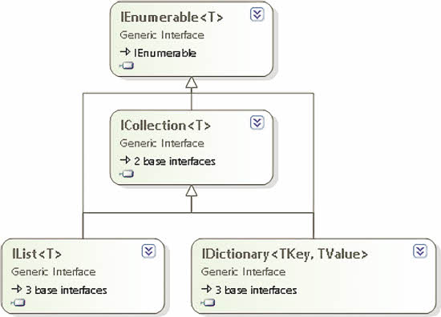
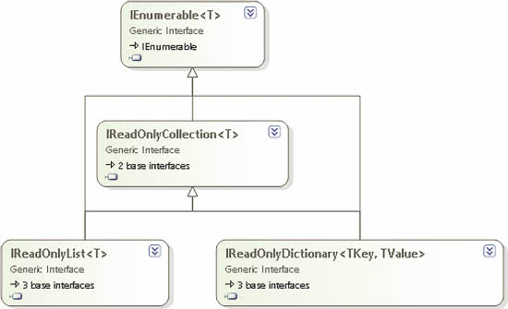
Mutable collections vs. read-only collections
Mutable collections
Read-only collections
  Figures from http://msdn.microsoft.com/en-us/magazine/jj133817.aspx

Slide 16
ReadOnlyCollection: Decorator design pattern
ReadOnlyCollection<T> implements IList<T>
  Some interface as any other List<T> and LinkedList<T>, but mutating operations throws NotSupportedOperationException
ReadOnlyCollection<T> aggregates ONE IList<T> object
  This IList<T> object will be decorated
Example: CollectionsTrying
Easy to use, but bad design
  Having a lot of public methods throwing NotSupportedOperationException

Slide 17
Thread safe collections
Ordinary collections | Thread safe collections
List<T>, ordered collection | none
none | ConcurrentBag<T>, not an ordered collection
Stack<T> | ConcurrentStack<T>
Queue<T> | ConcurrentQueue<T>
Dictionary<TKey, TValue> | ConcurrentDictionary<TKey, TValue>

Slide 18
Algorthm complexity: Big O
Big O indicates an upper bound on the computational resources (normally time) required to execute an algorithm
O(1) constant time
  The time required does not depend on the amount of data
  This is very nice!
O(n) linear time
  The time required depends on the amount of data.
  Example: Double data => double time
O(n^2) quadratic time
  The time required depends (very much) on the amount of data
  Example: Double data => 4 times more time
  The is very serious!!
O(log n)
  Better then O(n)
O(n*log N)
O(1) < O(log n) < O(n) < O(n*log n) < O(n^2)

Slide 19
Sorting in the C# API
Sorted collections
  SortedSet, SortedList, etc.
  Keeps elements sorted as they are inserted.
Sorting arrays
  Array.Sort(someArray)
    Uses the natural order (IComparable implemented on the element type)
  Array.Sort(someArray, IComparer)
    Uses QuickSort which is O(n * log n)
Sorting lists
  List.Sort() method
    Converts the list to an array and uses Array.Sort(…)
  Simple sorting
    Uses O(n ^ 2)
  Example: CollectionsTrying

Slide 20
QuickSort
Choose a random element (called the pivot) {or just pick the middle element}
Divide the elements into two smaller sub-problems
  Left: elements < pivot
  Right elements >= pivot
Do it again …
QuickSort is the sorting algorithm used in the List<T>.Sort()
  When the problem size is < 16 it uses insertion sort

Slide 21
Searching in the C# API
Binary search
  Searching a sorted list.
  Algorithmic outline: Searching for an element E
    Find the middle element
    If (E < middle Element) search the left half of the list
    Else search the right half of the list
  Using ONE if statement we get rid of half the data: That is efficient!
  O(log n)
  Array.BinarySearch() + Array.BinarySearch(IComparer)
  List.BinarySearch() + List.BinarySearch(Icomparer)
  Example: CollectionsTrying
Linear search
  Works on un-sorted lists.
  Start from the end (simple for loop) and continue till you find E or reach the end of the list.
  On the average you find E in the middle of the list – or continue to the end to conclude that E is not in the list
  O(n)

Slide 22
Divide and conquer algorithms
Recursively break down the problem into two (or more) sub-problems until the problem becomes simple enough to be solved directly.
The solution to the sub-problems are then combined to give the solution to the original (big) problem.
Examples:
  Binary search
    “Decrease and conquer”
  Quick sort
    Picks a random pivot (an element): Breaks the problem into two sub-problems:
      Left: smaller than pivot
      Right: larger than pivot
Source: http://en.wikipedia.org/wiki/Divide_and_conquer_algorithms

Slide 23
Hashing
Binary search is O(log n)
We want something better: O(1)
Idea:
  Compute a number (called the “hash value”) from the data are searching for
  Use the hash value as an index in an array (called the “hash table”)
  Every element in the array holds a “bucket” of elements
  If every bucket holds few elements (preferably 1) then hashing is O(1)

Slide 24
Hash function
A good hash function distributes elements evenly in the hash table
  The worst hash function always return 0 (or another constant)
Example
  Hash table with 10 slots
  Hash(int i) { return I % 10}
    % is the remainder operator
  Generally
    Hash table with N slots
    Hash(T t) { return operation(t) % N; }
      The operation should be fast and distribute elements well
C#, class Object
  Public virtual int GetHashCode()
  Every object has this method
  Virtual: You can (and should) override the methods in you classes
GetHashCode() and Equals()
  If the GetHashCode() send you to a bucket with more than ONE element, Equals() is used to find the right element in the bucket
  A.Equals(b) is true ⇒ a.GetHashCode() == b.GetHashCode()
  A.GetHashCode() == b.GetHashCode() ⇒ a.Equals(b) not necessarily
  A.GetHashCode() != b.GetHashCode() ⇒ a.Equals(b) is false

Slide 25
Hash table
A hash table is basically an array.
2 elements computes the same hash value (same array index)
  Called a collision
  More elements in the same bucket
    Searching is no longer O(1)
Problem
  If a hash table is almost full we get a lot of collisions.
  The load factor should be < 75%
Solution: Re-hashing
  Create a larger hash table (array) + update hash function + move elements to the new hash table
  That takes a lot of time!!

Slide 26
References and further readings
MSDN Collections (C# and Visual Basic)
  http://msdn.microsoft.com/en-us/library/ybcx56wz.aspx
Deitel & Deitel: Visual C# 2012, 5th edition
  Chapter 21 Collections, page 852-885
John Sharp: Microsoft Visual C# 2012 Step by Step,
  Chapter 8 Using Collections, page 419-439
Bart De Smet: C# 5.0 Unleashed, Sams 2013
  Chapter 16 Collection Types, page 755-787
Landwert: What’s new in the .NET4.5 Base Class Library
  Read-Only Collection Interfaces
  http://msdn.microsoft.com/en-us/magazine/jj133817.aspx

