Slide 1
Threads in C#

Slide 2
Benefits of using threads
All modern computers has many cores (CPU’s)
  Dual core, quad core, etc.
  By dividing the program into more threads the program can utilize these cores
    The program will run faster
    One thread, means only one core used – other cores a idle
Process request simultaneously on servers
  Client request arrive concurrently – and they are processed concurrently
Keeping the user interface responsive
  Time-consuming tasks should execute in parallel with the UI thread.

Slide 3
Threads vs. processes
Threads share memory
  Communication between threads
    One thread updates memory (data), another thread read this memory (data)
  Each thread has a separate call stack
Processes do no share memory
  Communication between processes
    Sockets, etc.
  Operating systems has processes
Threads and processes both run in parallel.
This slide show is about threads, not processes.

Slide 4
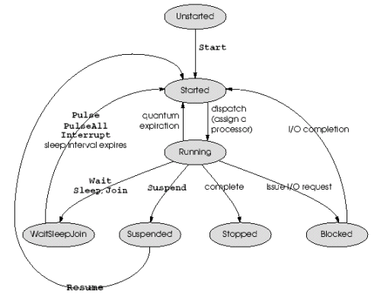
The lifecycle of a thread
More benefits of using threads
Source: http://stackoverflow.com/questions/8966636/thread-lifecycle-in-net
A thread may be waiting for something to happen
  File to be read
  Incoming network requests
  Sleep()
  Wait()
While one thread is waiting other thread should use the CPU
  The program will run faster

Slide 5
Interleaved concurrency vs. non-interleaved concurrency
Interleaved concurrency
  Instructions for each thread are interleaved (they take turns)
    T1, T1, T2, T2, T1, T2
  Can be done with a single core
  If one thread is block other threads can continue running
(Real) concurrency
  More threads are running in parallel, at the same time.
Design has to be prepared for both interleaved and non-interleaved concurrency
  You never know how many cores your threads will have access to

Slide 6
Parallelism
“Parallelism entails partitioning work to be done, running processing on those pieces concurrently, and joining the results. Parallelizing a problem generates concurrency”
  Hillar: Professional Parallel Programming with C#, Wrox 2011, page 19
Correctness
  For all different number of cores, and possible interleaving, the result must be correct.
  That is hard! Requires a lot of thinking when designing!!

Slide 7
Class Thread, construction + starting
Thread(ThreadStart start)
  Delegate void ThreadStart()
  This constructor works with any void method with no parameters, void M()
  The method can be static or not
  Starting: call Start()
Examples: TryThread
Source
  http://msdn.microsoft.com/en-us/library/System.Threading.Thread.Thread(v=vs.110).aspx

Slide 8
Thread constructors with lambda expressions
Using a lambda expression as the parameter to the Thread constructor
  you can give any number of parameters to the called method and the parameters can be typed (not object)
Examples: TryThread

Slide 9
Name property
Threads have names
  Good for debugging etc.
Thread tr = new Thread(…)
  tr.Name = ”some name”;
  Thread.CurrentThread.Name, used in the working method
    CurrentThread is a static property of Thread
Example: TryThread

Slide 10
Sleep method
Thread.sleep(500);
  Suspends the current thread for 500 milliseconds.
    The thread will not be scheduled for execution for 500 milliseconds
  Static method in the Thread class
Example: TryThread

Slide 11
Join method
someThread.Join()
  Blocks the calling thread until someThread terminates.
  Throws ThreadInterruptedException if the thread is interrupted while waiting.
Bool someThread.join(millisecondsTimeout)
  Blocks the calling thread until a thread terminates or the specified time elapses
  Return true if the thread terminated, false if there was a timeout.

Slide 12
Priority property
Property to get / set the priority of the thread
Determines how much execution time the thread gets
Public ThreadPriority { get; set; }
  Enum ThreadPriority {Lowest, BelowNormal, Normal, AboveNormal, Highest}
Set the priority before you start the thread

Slide 13
Interrupting a thread
Threads can be interrupted (by another thread)
  Even if the thread is sleeping or blocked for other reasons.
Syntax:
  threadObj.Interrupt()
Semantics
  In the interrupted class ThreadInterruptedException is thrown.
Usage:
  Can be used to stop another thread
Example: TryThread -> TryInterrupting

Slide 14
Exceptions in threads
If a thread throws an exception the application terminates.
The thread should catch its own exceptions.
Trying to wrap the Start() in try … catch has no effects.
  It is not Start() that throws the exception
Example: TryThread -> ThrowException

Slide 15
Foreground and background threads
By default threads are foreground threads.
As long as a foreground thread is alive, the application is alive.
If only backgrounds threads are alive, the application finishes.
When the application finished, all background threads are terminated immediately.
Example
  someThreadObject.IsBackground = true;

Slide 16
Thread pooling
New Thread(…) is expensive
  Making a new Thread object takes time + memory (app 1 MB stack)
Thread pools recycle Thread objects
  Thread object which has finished executing, are put back into the pool
    They are not considered garbage.
  We will make fewer Thread objects, saving time + memory
Threads run with by the pool are background threads
  They are terminated as soon as then application terminates
  In a simple program you can add Console.ReadLine() to the end of the program to keep the application alive.

Slide 17
Thread pooling, how to
Task.Run(someMethod) is simpler than
  someMethod must have a signature
    Void someMethod()
  Creates a Task object and runs it in the background!

Slide 18

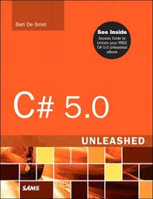

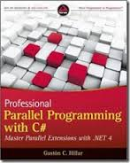
References and further readings
Joe Albahari: Threading in C#, part 1 Getting Started
  http://www.albahari.com/threading/
John Sharp: Microsoft Visual C# 2012, Microsoft Press, 2012
  Chapter 23 Improving Throughput by Using Tasks, page 541-584
Bart De Smet: C# 5.0 Unleashed, Sams 2013
  Chapter 29 Threading and Synchronization, page 1443-1511
Mark Michaelis: Essential C# 5.0, Addison Wesley 2013
  Chapter 18 Multithreading, page 727-808
Gaston Hillar: Professional Parallel Programming with C#, Wrox 2011
  547 pages

