Slide 1
Threads
Critical sections, locking, monitors, etc.

Slide 2
Critical sections
Some lines in the program needs sequential executions
To avoid incorrect results
The designer / programmer must find the critical sections
And that can be hard!
The critical section must be protected against concurrency.
More critical sections, means less concurrency
Example: ThreadBank, without lock

Slide 3
Thread safe objects
An object is thread safe if it is ready to be used with more than one thread.
How to obtain thread safety
Immutable objects (like String)
All critical sections are protected, so that at most one thread can work inside the critical section (on this object)
Other methods

Slide 4
Locking, the keyword lock
Syntax
lock(someObject) { …. Statements = Critical section … }
Semantics
Obtains the mutual exclusion lock for someObject, executes the critical section, and releases the lock.
No other thread can work in any critical section, locked by someObject
Example: ThreadBank

Slide 5
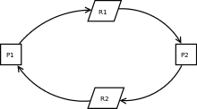
Deadlock
Deadlock is a two (or more) threads are waiting on each other.
Example: Bank, transfer money from account A to account B. If two customers do transfer at the same time deadlock might occur
One customer has a lock on account A and wants a lock on account B
Another customer has a lock on Account B and wants a lock on Account B
Example: ThreadBank

Slide 6
Deadlock handling
Running a C# program there is no automatic deadlock detection or handling.
The program just hangs …
The programmer must be careful when acquiring locks.
Deadlock prevention
Try to use lock free algorithms
Number the resources and only acquire resources with a higher number
Etc.

Slide 7
Monitor class
Monitor is a class with some static methods
Do not make objects from the Monitor class
Monitor vs. lock(…)
lock(someObject) { …. Statements = Critical section … }
Is equivalent to
Bool lockTaken = false;
Try { Monitor.Enter(someObject, ref lockTaken);
… critical section … }
Finally { if (lockTaken) Monitor.Exit(someObject); }
Semantics
Monitor.Enter obtains the lock on someObject. This prevents other threads from entering the block.
Monitor.Exit releases the lock.
Monitor.Exit should always be in a finally block to make sure the lock is released even if there was an exception in the block
lockTaken is necessary in case there was an exception at Monitor.Enter(…)

Slide 8
Monitor, Wait and Pulse
Problem
Entering a synchronized method a thread might realize that it is not in a state to fulfill its task – and it cannot simply return from the method because the return value is not “ready”.
Solution
Use a monitor and ask it to wait for another thread to do something.
Monitor class, with static methods
Wait
Monitor.Wait(someObject);
Monitor.Wait releases the lock and suspends the thread from running.
No busy waiting!
Pulse
Monitor.PulseAll(someObject)
Notifies all threads waiting on someObject.
Monitor.Pulse(someObject)
Notifies on thread waiting on someObject

Slide 9
Wait “code pattern”
While (conditionDoesNotHold) {
Monitor.Wait(someObject);
}
// critical section
Monitor.Wait(…) should always be called in a loop, since Monitor.PulseAll(…) wakes up all thread waiting for the object.
Only the first (quickest) should execute the critical section. Other thread go back to wait (because of the while loop)

Slide 10
Task parallelism vs. Data parallelism
Data parallelism
Lots of data, same operation applied to all data.
Example: Encrypting 100 passwords
Task parallelism
Many different operations can run currently.
Example: Similar to what an operating system does all the time
Pipelining
Mix of task and data parallelism.
Requires coordination between multiple concurrent tasks
Tasks with queues to hold partial results
Example: Password cracking
Read encrypted passwords -> make variations -> encrypt -> compare to password file
General example: Producer-Consumer

Slide 11
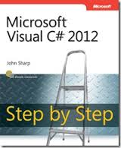
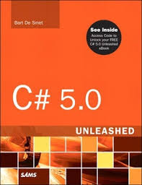
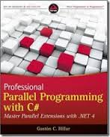
References and further readings
Joe Albahari: Threading in C#, part 1 Getting Started
http://www.albahari.com/threading/
John Sharp: Microsoft Visual C# 2012, Microsoft Press, 2012
Chapter 23 Improving Throughput by Using Tasks, page 541-584
Bart De Smet: C# 5.0 Unleashed, Sams 2013
Chapter 29 Threading and Synchronization, page 1443-1511
Mark Michaelis: Essential C# 5.0, Addison Wesley 2013
Chapter 18 Multithreading, page 727-808
Gaston Hillar: Professional Parallel Programming with C#, Wrox 2011
547 pages

