Slide 1
Events in C#

Slide 2
Delegates vs. Events
Delegates can be used as events
    Example CountDownTimerEvent -> CountDownDelegate
  But have certain problems
    Delegate can be “hijacked”
    Outsiders can make additional events
The Event type overcomes these problems
  Example CountDownTimerEvent -> CountDownEvent

Slide 3
Event syntax
New keyword: event
  General syntax
    Public event SomeDelegateType SomeName;
  Examples
    Public event Action Finished;
    Public event Action<uint> Tick;
Adding (attaching) and removing (detaching) event handlers
  Event handlers are method implementing the Delegate Type
  Add using the += operator
  Remove using the -= operator
  Example: CountDownTimerEvent

Slide 4
Raising events: Beware of null!
Unassigned events are null!
Careful when you raise an event
  If (Tick != null) Tick(3);
  Is dangerous if another thread detaches a handler right after the if condition is evaluated
Example: CountDownTimerEvent
Why is the event null, and not just an empty List or something?
  Some classes has a lot of events, of which most are hardly ever used
  And we do not want to have a lot of empty List objects in memory

Slide 5
Some classes have lots of different events
A Windows Forms Button has 68(!) events
Some examples
  BackgroundColorChanged
  BackgroungImageChanged
  Click
  DoubleClick
  DragDrop
  FontChanged
  GotFocus
  KeyDown
  MouseHover
  Resize
  And a lot more …
Most of these events you would never ever use

Slide 6
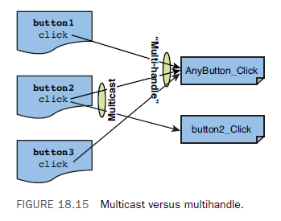
Many-to-many relationship
Multicast events
  One event can raise multiple event handlers
Multi-handle
  One event handler can handle events from multiple sources

Slide 7
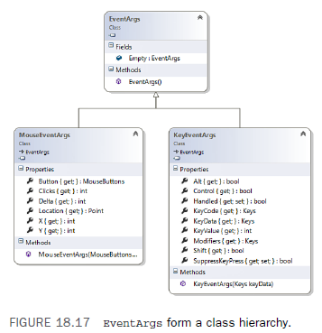
Windows Forms:
Event Handlers and EventArgs
The delegate type Action can be used as the basis for GUI events, but it is not use as it is …
Windows Forms event handlers
  EventHandler, for button clicks
    Delegate void EventHandler(Object sender, EventArgs e)
  KeyEventHandler, for keyboard
    Delegate void KeyEventHandler(Object sender, KeyEventArgs e)
  MouseEventHandler, for mouse events
    Delegate void MouseEventHandler(Object sender, MouseEventHandler e)
  Etc.

Slide 8
WPF: Event handlers and RoutedEventArgs
WPF = Windows Presentation Foundation
  GUI API as Windows Forms, but newer
Example: concurrency -> SimpleBrowserAsync
RoutedEventArgs : EventArgs
  RoutedEventArgs extends EventArgs
Example: CountDownTimerEvent -> CountDownWpfApp

Slide 9
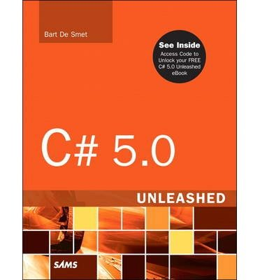

References and further reading
MSDN Events Tutorial
  http://msdn.microsoft.com/en-us/library/aa645739(v=vs.71).aspx
Bart De Smet: C# 5.0 Unleashed, Sams 2013
  Chapter 18: Events, page 843-911
Nagel et al. Professional C# 5.0 and .NET 4.5.1, Wrox 2014
  Chapter 8: Delegates, Lambdas, and Events, page 183-208

