Slide 1
Generics in C#

Slide 2
Generics List<T> vs. non-generic ArrayList
Generic List<T>
Namespace System.Collections.Generic
Non-generic ArrayList
Namespace System.Collections
List<String> list = new List<String>();
List.add(”Anders”);
List.add(22);
  Rejected by the compiler
String str = List.get(0);
Example: GenericsUsing
ArrayList list = new ArrayList();
List.add(”Anders”);
List.add(22);
  Objects of any type can be added to the list
Object obj = list.get(0);
String str = (String)obj;
  Type cast necessary

Slide 3
Generics, what is it?
”Generics introduce to the .NET Framework the concept of type parameters, which make it possible to design classes and methods that defer the specification of one or more types until the class or method is declared and instantiated by client code. For example, by using a generic type parameter T you can write a single class that other client code can use without incurring the cost or risk of runtime casts”
  Generics (C# Programming Guide)
  http://msdn.microsoft.com/en-us/library/512aeb7t.aspx

Slide 4
Writing a generic class
Class SomeName<T> {
// T can be used inside the class as
// parameter type
// return type
// property type
}
Naming convention: The type parameter is usually called ‘T’ (or TSomething)
  sounds like Type
Example: GenericsUsing

Slide 5
Default values
Sometimes you need to get a default value for a generic type parameter
  Example: T find(int id)
  If there is no element with the specified id we want to return the default value
Default values
  Null: References types, like String, etc.
  O: int, etc.
  False: bool
  Default value table
    http://msdn.microsoft.com/en-us/library/83fhsxwc.aspx
Syntax
  default(T)
  T find(int id) { …. return default(T); }

Slide 6
Generic constraints
In a generic class, all you can do to a variable of the type parameter, are the operations defined in the class Object
  That is not much! ToString(), Equals(), etc.
  If you want more you must constrain the type parameter
Generics constraints guarantees that the type has certain operations
Example: GenericConstraints
Syntax
  Class SomeName<T> where T : constraint { … }
  Class SomeName<T> : ISomeInterface where T : constraint { … }
Different types of constraints
  http://msdn.microsoft.com/en-us/library/d5x73970.aspx

Slide 7
Generic methods
Methods, as well as classes + interfaces, can be generic.
Generic methods are usually static
Example String.Join(…) method
  Public static string Join<T>(string separator, IEnumerable<T> values)
Example Enumerable.Where(…) method
  http://msdn.microsoft.com/en-us/library/bb534803(v=vs.110).aspx

Slide 8

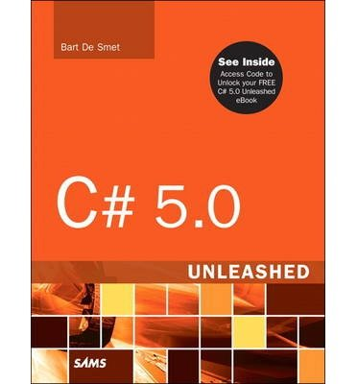
References and further readings
MSDN Generics (C# Programming Guide)
  http://msdn.microsoft.com/en-us/library/512aeb7t.aspx
John Sharp: Microsoft Visual C# 2012 Step by Step
  Chapter 17 Introducing Generics, page 389-418
Bart de Smet: C# 5.0 Unleashed, Sams 2013
  Chapter 15 Generic Types and Methods, page 701-754

