Slide 1
Inside LINQ to Objects
How LINQ to Objects work

Slide 2
IEnumerable<T> and IEnumerator<T>
Two important interfaces in LINQ to Objects
IEnumerable<T> is a very simple, single method interface
  Interface IEnumerable<T> {
  IEnumerator<T> GetEnumerator()
  }
  IEnumerable<T> is implemented by a lot of classes
    List, Array, HashSet etc.
  A LINQ expression returns a IEnumerable<T> object
  IEnumerable<T> is used in foreach statements
IEnumerator<T> is a slightly more complex interface: It has 3 methods
  Interface IEnumerator<T> {
  bool MoveNext();
  T Current();
  void Reset();
  }

Slide 3
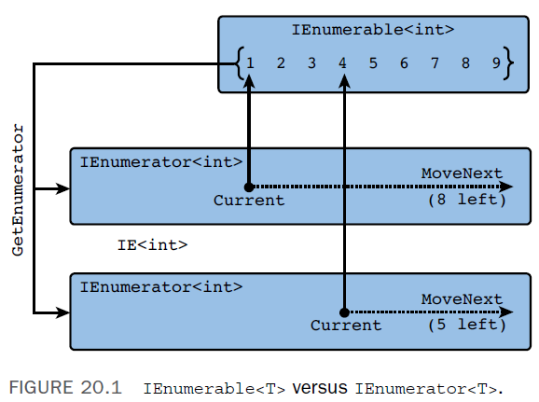
Why do we need two interfaces?
IEnumerator<T> is a “machine” that can visit all the elements in a collection.
A collection implements IEnumerable<T>
  A “machine” factory!
  A collection can have any number of IEnumerator<T> objects working on it.
    Each IEnumerator<T> object has its own Current property.
Source: Bart De Smet, C# 5.0 Unleashed, page 979

Slide 4
LINQ to Objects Extension Methods
LINQ to Objects queries are translated into LINQ to Objects method expression syntax
  var query = from x in xs where x % 2 == 0 select x + 1;
  Is translated to
  xs.Where(x => x % 2 == 0).Select(x => x +1);
Where and Select are so-called extension methods.
  They work on IEnumerable<T> objects (input) and return IEnumerable<T> object (output)
    Makes is possible to chain method calls (like above)
  However, Where and Select are not methods defined in the IEnumerable<T> interface
  They are special extension methods
    They extends IEnumerable<T> …
  Examples: ExtensionMethods

Slide 5
Extension Methods: Technical requirements
Extension Methods can be define on any class
  Not just IEnumerable<T>
  Example: String.Reverse() ExtensionMethods
An Extension Method must be declared inside a static class
  static class SomeName { … }
  You cannot create objects from a static class
An Extension Method must be static
The first parameter of an Extension Method must be marked this
  public static String Reverse(this String str)

Slide 6
Unit testing LINQ
LINQ statements can be unit tested using the extension method SequenceEquals(…)
  It returns true if two LINQ statements returns the same sequence of elements
  Assert.IsTrue(lint.SequenceEquals(expected));
  Example: linqFirstTry

Slide 7
Iterators, yield return
Implementing the interfaces IEnumerable<T> and IEnumerator<T> requires quite a lot of (boring) programming
  But there is a easier way …
  C# introduced some syntactic sugar to help you writing fewer lines
Example
  IEnumerable<int> GetIntegers() {
  for (int i = 0; i < 100; i++) {
  yield return i;
  }
  }
Iterators can consume other iterators
  Pulling elements through a chain of filters
  Example: PasswordCrackerLinq

Slide 8
Iterators are lazy
Iterators are lazy
  Iterators returns an element only when they are asked to
Elements are pulled through the chain of iterators
  Example: PasswordCrackingLinq
Checking parameters is lazy, as well
  They are not checked until the first call to MoveNext()
  Example: PasswordCrackingLinq -> Variations(…)
Eager methods include
  ToList(), ToArray(), Min(), etc.

Slide 9
PLINQ = Parallel LINQ
LINQ statements can be executed concurrently
AsParallel()
  Another iterator
  Executes the FOLLOWING iterator in parallel
  PLINQ decides how many threads will be used
Examples: PlinqTrying

Slide 10
Functional programming
A programming paradigm
Computation = evaluation of mathematical functions
  No state
  No side effects
Programming languages
  LISP
  Haskell
  F#
  C# lambda expressions + LINQ (may include side effects)

Slide 11
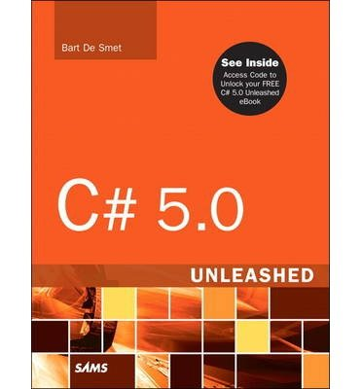
References and further readings
Bart De Smet: C# 5.0 Unleashed, Sams 2013
  Chapter 10 Methods: section Extension Methods, page 524-534
  Chapter 20 Language Integrated Query Internals, page 977-1055
MSDN Extension Methods (C# Programming Guide)
  http://msdn.microsoft.com/en-us//library/bb383977.aspx
MSDN Parallel LINQ (PLINQ)
  http://msdn.microsoft.com/en-us/library/dd460688(v=vs.110).aspx

