Slide 1
LINQ
Language Integrated Query

Slide 2
LINQ: Why and what?
Problem
  Many data sources: Relational databases, XML, in-memory data structures, objects, etc.
  Each data source has an access language: SQL, DOM, etc.
Solution
  LINQ
  One unified access language working on all kinds of data sources
The name
  Language Integrated
    Some new keywords was introduced to the C# programming language
    The C# compiler checks the syntax
      Unlike SQL , which is just a test string to the C# compiler
  Query
    It’s all about querying data source
      Getting data out of the data source

Slide 3
Data sources
In-memory data sources
  Arrays, int[] data = new int[] {3,4,5,6};
  List<T>
  ArrayList
  Special “version”: LINQ to Objects
Relational databases
  Special “version”: LINQ to SQL
XML documents
  Special “version”: LINQ to XML

Slide 4
LINQ basic syntax: Comparable to SQL
LINQ
SQL
From product in products
Where condition
Select new { product.Name, product.Price }
Starting with the from clause makes is easier to use IntelliSense help
Select Name, Price
From products
Where condition

Slide 5
Filtering
From … where condition … select …
The where clause is optional
  If it is missing you select every element from the data source
The condition must evaluate to either true or false
Example: linqFirstTry -> CheapProducts

Slide 6
Projection using the select clause
Decide which properties should be returned
Syntax
  From … where condition … select …
Select the whole object
Select a single property
Select a number of properties
  Use Anonymous types
  From p in P Select new {p.prop1, p.prop2}
Example: linqFirstTry -> CheapProducts + SelectExample

Slide 7
Ordering
Select … where … orderby … direction
Direction may be either ascending or descending
  Default is ascending
Sorting by more than one attribute
  If is possible to sort by more than one attribute
    Orderby primary, secondary, etc.
  Example linqFirstTry -> Ordering + JoiningMemoryUsers

Slide 8
Non-generic data source
Selecting from a non-generic data source, like an ArrayList, requires a little extra
  ArrayList arrayList = new ArrayList();
  arrayList.Add("Anders");
  arrayList.Add("John");
  arrayList.Add("Peter");
  var longNames = from String text in arrayList where (text.Length >= 5) select text;
If the data source happens to have members other than the specified type, the program compiles but you get an InvalidCastException at runtime
  arrayList.add(47) → InvalidCastException
Conclusion: Try to avoid non-generic data sources!

Slide 9
LINQ with expression syntax
Ordinary LINQ
  Special keywords
  From … where … select
LINQ with expression syntax
  Calling methods on IEnumerable<T>
Example: linqFirstTry -> main -> QuerySyntaxExamples

Slide 10
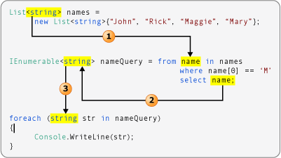
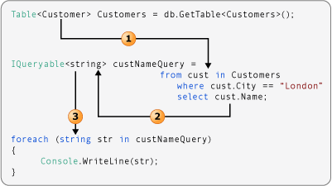
Type relationships
Source: http://msdn.microsoft.com/en-us/library/bb397924(v=vs.100).aspx

Slide 11
Join
Database
  Join = select from more tables
LINQ
  Select from more data sources
  Example
    LinqFirstTry -> Joining
    LinqFirstTry -> JoiningMemoryUsers

Slide 12
LINQ on Databases
LINQ to SQL
  LINQ is converted to SQL, which is sent to the database management system
Example
  LinqToSqlNorthwind

Slide 13
LINQ on XML documents
LINQ to XML
  XML is untyped (if you are not using an XML schema)
    It is basically text strings
      Strings must be converted to numbers, etc.
Example: LinqToXmlTrying

Slide 14
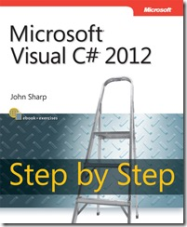
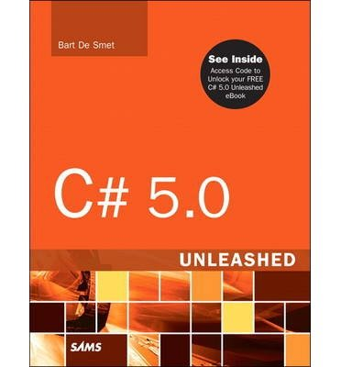
References and further readings
MSDN LINQ (Language-Integrated Query)
  http://msdn.microsoft.com/en-us/library/bb397926.aspx
John Sharp Visual C# 2012, Microsoft Press 2012
  Chapter 21 Querying In-Memory Data by Using Query Expressions, page 491-514
  Chapter 24 Improving Response Time by Performing Asynchronous Operations
    Using PLINQ to Parallelize Declarative Data Access, page 599-605
Bart De Smet: C# 5.0 Unleashed, Sams 2013
  Chapter 19 Language Integrated Query Essentials, page 913-975

