Slide 1
SOLID design
Five design principles

Slide 2
SOLID, what is it?
Single responsibility principle
  A class should have only a SINGLE responsibility
    Change in the specification on that responsibility should only affect this class
Open/close principle
  Each class should be open for extensions (sub-classes), but closed for modifications
    We should never need to modify an existing class
Liskov substitution principle
  Objects in a program should be replaceable with instances of their subtypes without altering the correctness of that program.
  Named after Barbara Liskov
Interface segregation principle
  Many client-specific interfaces is better than one general purpose interface
Dependency inversion principle
  Depend on abstractions, not on concretions

Slide 3
SOLID, what is it used for?
The SOLID principles are used as a guideline
  Designing systems
  Refactoring systems
    Detecting “smells” in code
    Refactor until the code is SOLID

Slide 4
Single responsibility principle
Based on cohesion
A class should do only one thing
Separation of concerns

Slide 5
Open/close principle
Open for extensions
  Sub-classes
Closed for modifications
New functionality should be placed in sub-classes
  Overriding methods from the base class

Slide 6
Interface segregation principle
  Many client-specific interfaces is better than one general purpose interface
Clients should not be forced to depend upon interfaces that they don't use

Slide 7
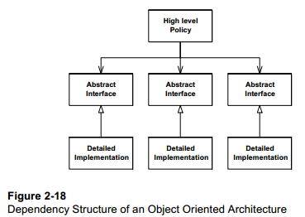
Dependency inversion principle
Depend on abstractions, not concretions
  Abstractions = interfaces
  Concretions = classes
Loose coupling
Figure from Robert C. Martin http://www.objectmentor.com/resources/articles/Principles_and_Patterns.pdf

Slide 8
References and further readings
Robert C. Martin Design Principles and Design Patterns, 2000
  http://www.objectmentor.com/resources/articles/Principles_and_Patterns.pdf
michas The S.O.L.I.D Object Oriented Programming (OOP) Principles, 2010
  http://www.codeproject.com/Articles/60845/The-S-O-L-I-D-Object-Oriented-Programming-OOP-Prin
Design Principles
  http://www.oodesign.com/design-principles.html

