Slide 1
References types and Value types
With a very brief introduction to struct and enum

Slide 2
Value types
Value types
Reference types
Values
Value types are (normally) immutable
  You cannot change the state of an object after it the object has been created
Passing a parameter of a value type, means giving a copy to the called method.
Some value types
  Class System.ValueType
    Base class of all value types
  Int, bool, double, etc.
  DateTime, Point, Color
  Struct { … }
  Enum { … }
Objects
Reference types are (normally) mutable
Passing a parameter of a reference type, means giving a reference to the called object
Some reference types
  String (immutable!!)
  Class Something { … }
  Arrays

Slide 3
Memory: Heap vs. Stack
A running program (called a process) has two sorts of memory allocated
  Heap
  Stack
Heap
  Object are allocated on the heap.
  The garbage collector “cleans” the heap
  New SomeReferenceType()
    The new object is allocated on the heap
  Threads share the heap
    References to the object on the heap
Stack
  For every method call data is pushed on the stack
  For every return data is popped of the stack
  Data: parameters + local variables
  New SomeValueType()
    The value is allocated on the stack
  Threads do not share stack

Slide 4
Struct
Similar to a class, but simpler
  No inheritance etc.
Struct Pair { …. }
Value type
  Values are allocated on the stack, not the heap
Some struct types from the C# API
  System.DateTime
  System.Windows.Point
Example: StructVsClass

Slide 5
Enums
An Enums is a set of constant values
Example declaration: enum Color { Red, Green, Blue };
  Color is a type with only 3 legal values
Example usage: Color MyColor = Color.Blue;
Enum types extends the System.Enum type
Some enum types from the C# API
  System.DayOfWeek
    Monday, Tuesday, …
  System.StringComparison
    Different ways to compare strings: culture, ignore case, etc.

Slide 6
Enums + switch statement
Enums are really integers
  Red = 0, Green = 1, Blue = 2
  However, only 3 values are legal
Enum types are often used in switch statements
Color MyColor = …
Switch (MyColor) {
case Color.Blue: … break;
case Color.Red: … break
}

Slide 7
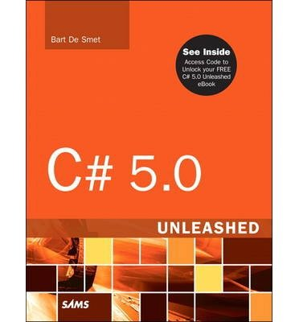
References and further readings
MSDN Structs (C# Programming Guide)
  http://msdn.microsoft.com/en-us/library/saxz13w4.aspx
Bart De Smet: C# 5.0 Unleashed, Sams 2013
  Chapter 9 Introducing Types
    Classes Versus Structs, page 466-486
MSDN Enumeration Types (C# Programming Guide)
  http://msdn.microsoft.com/en-us/library/cc138362.aspx
Bart De Smet: C# 5.0 Unleashed, Sams 2013
  Chapter 11 Fields, Properties, and Indexers
    An Intermezzo About Enums, page 563-574

