Slide 1
Xamarin.Forms
A very brief introduction

Slide 2
Cross platform
Android
iOS
Windows Universal App
Share the UI

Slide 3
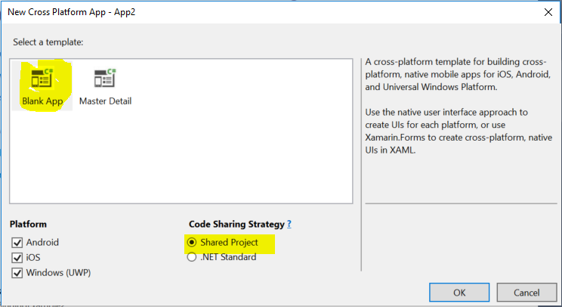
Visual Studio support: Creating a new project

Slide 4
XAML and C# code
Each page has a XAML file
Android: Each Activity has an XML layout file
Each page has a C# class
Android: Each Activity has a Java class
The XAML file and the C# class are parts of the same class
Partial class
No need for findViewById(…)
Nothing like that in Android

Slide 5
OnClick event handler
The UI element must have a name (similar to id in Android)
<Button Text="Add" x:Name="ButtonAdd"/>
C# code
ButtonAdd.Clicked += (sender, args) => { … handle … }
A signel button can have several handlers

Slide 6
Navigation to another Page
Android: Intent + startActivity(…)
App.xaml.cs
MainPage = new NavigationPage(new MainPage());
await Navigation.PushAsync(showPage);
Example: CollectWords
Parameters
Android intent.putExtra(name, value)

Slide 7
Data binding
”Data bindings connect properties of two objects, called the source and the target”
https://docs.microsoft.com/en-us/xamarin/xamarin-forms/xaml/xaml-basics/data-binding-basics
View-to-View bindings
”You can define data bindings to link properties of two views on the same page”
Example: BindingExample

Slide 8
Life cycle
App.xaml.cs

